Slide 1
Connected Home Council (CHC) Webinar Meeting will commence 12:05pm ET May 21, 2024 | 12 PM – 1:30 PM (ET)
CHC Chair: Ken Wacks (Ken Wacks Associates)
Vice-Chair: Charlie Derk (Legrand)
Vice-Chair: Joshua Gerena (2N/Axis Communications)

Slide 2
1. Agenda Greg Walker(ASHB)
Agenda
Call to Order, Welcome, Introductions, About the CHC
Appointment of New CHC Vice-Chair
Administrative
Research Update
Keynote: Connected Living, Unleashing the Power of Smart Home Security – Josh Gerena of 2N/Axis Communications
ASHB Journal
ASHB Whitepapers
ASHB Podcast
New Business
Announcements
Adjournment
2

Slide 3
2. Call to Order, Welcome, Intro, About the CHC Ken Wacks (Ken Wacks Associates)
About the CHC
Established in 2004, the ASHB Connected Home Council initiates and reviews projects that relate to connected home and multiple dwelling unit technologies and applications. The Council also examines industry opportunities that can accelerate the adoption of new technologies, consumer electronics and broadband services within the burgeoning connected home market. www.ashb.com/chc
CHC Chair
Dr. Kenneth Wacks
Management &
Engineering
Consultant
CHC Vice-Chair
Charlie Derk
Vice President of
Strategy
CHC Vice-Chair
Joshua Gerena
Segment Development Manager - CRE
3

Slide 4
3. Appointment of New CHC Vice-Chair Ken Wacks (Ken Wacks Associates)
ASHB Welcomes Newly Appointed CHC Vice-Chair
Joshua Gerena is an accomplished professional, currently serving as the Segment Development Manager for commercial real estate (CRE) at Axis Communications for the Americas. In this pivotal role, he plays a key part in formulating and executing strategies to enhance Axis’ presence across commercial, multi-tenant, and residential sectors. With over two decades of practical experience spanning low voltage, electrical, and electronic manufacturing industries, Josh possesses a deep understanding of commercial audio, pro audio, video, access control, and intercom systems. His primary focus is on leveraging smart home and smart building technologies to drive industry innovation.
Josh has held influential roles across various sectors of the industry. He has served as a Sales Director, Sales Manager, and partner of a Rep firm, where he played a pivotal role in driving sales growth and developing strategic partnerships. Furthermore, Josh has a track record of success in building entire sales teams for different manufacturers, showcasing his expertise in team leadership and development.
Throughout his career, Josh has been instrumental in providing cutting-edge technology solutions to organizations of all sizes throughout the Americas. His dedication to excellence is evidenced by an extensive array of credentials and certifications, including MCSE, MCSA, MOSS, CCNP, 2N Certified, Cisco CCNA, and CCNP, supplemented by further Genetec certifications.
Additionally, Joshua Gerena is an alumnus of the Institute of Audio Research in NYC, where he refined his skills and knowledge in audio engineering, contributing to his expertise in the field.
CHC Vice-Chair
Joshua Gerena
Segment Development Manager - CRE
4

Slide 5
3. Administrative Ken Wacks (Ken Wacks Associates)
Motion to approve past IBC Minutes March 12, 2024
www.ashb.com/ibc
5

Slide 6
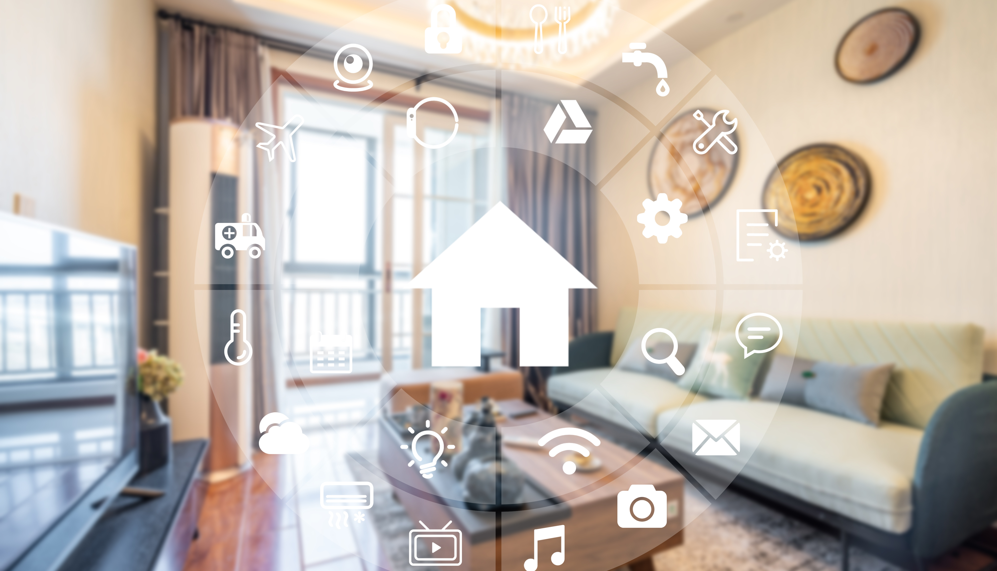
4. Research Update Greg Walker(ASHB)
2024 CHC Landmark Research
Smart Home Trends & Technology Adoption
6

Slide 7
5. Keynote Charlie Derk (Legrand)
7

Slide 8
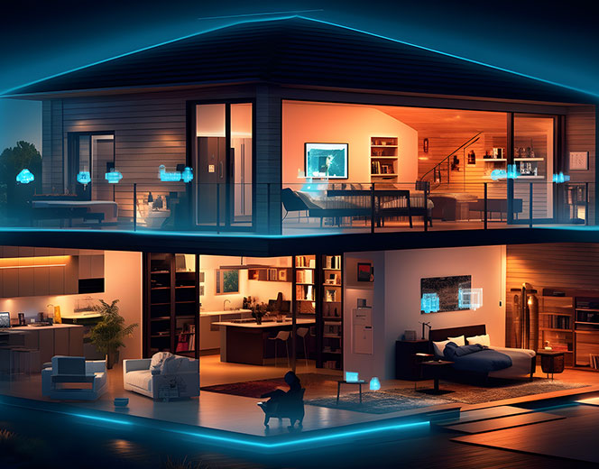
Joshua Gerena
Unleashing the Power of Smart Home Security
Segment Development Manager
COMMERCIAL REAL ESTATE

Slide 9
Unleashing the Power of Smart Home Security

Slide 10
What is Smart Home Security?
Notes:
What is Smart Home Security?
Smart home security refers to the integration of smart technology and devices into a home's security system to enhance safety, convenience, and control. These systems leverage internet connectivity, automation, and advanced sensors to provide comprehensive monitoring and protection of residential properties.

Slide 11
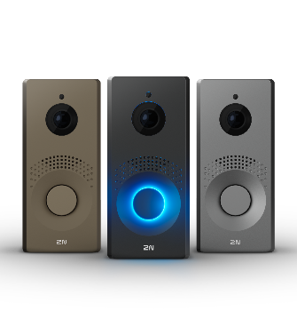
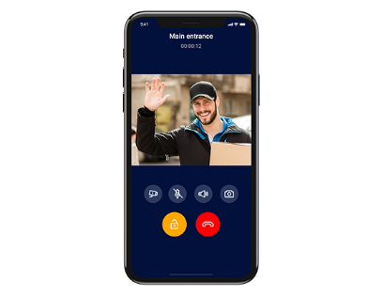
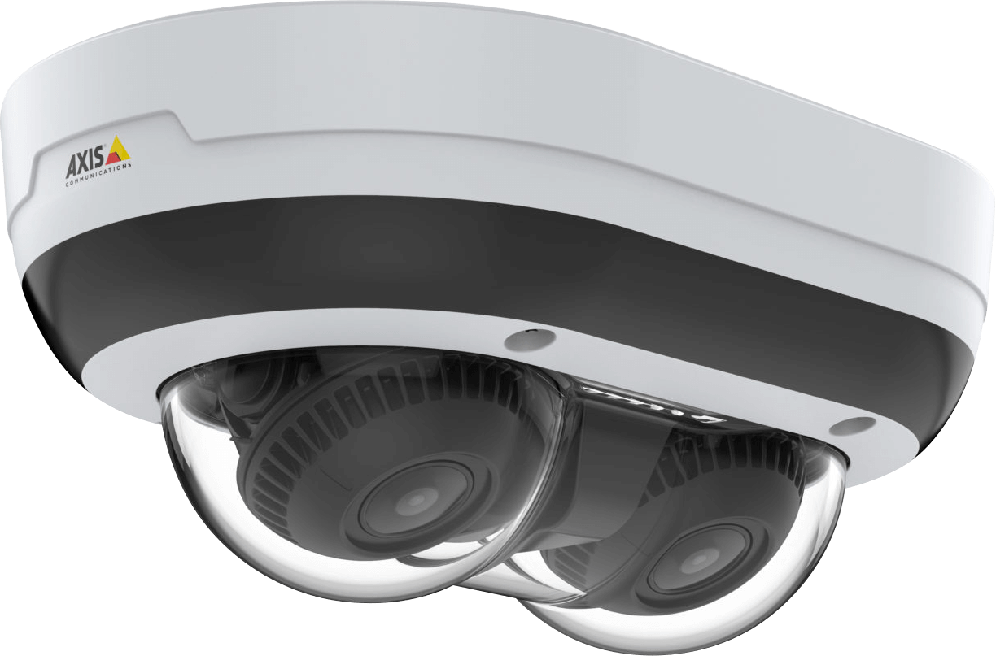
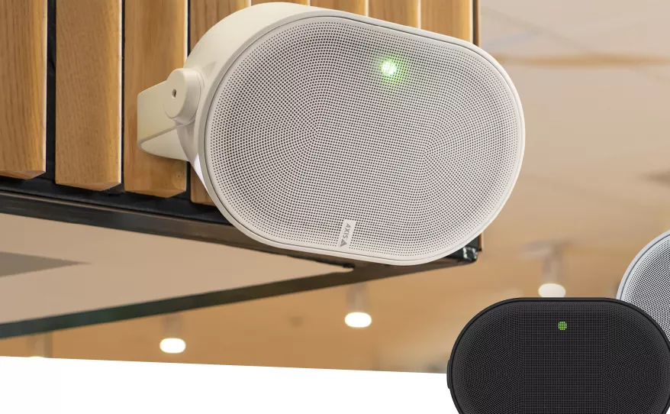
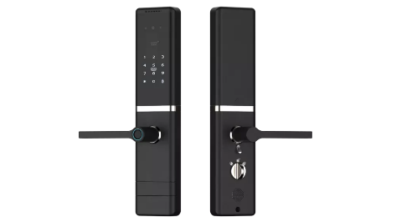
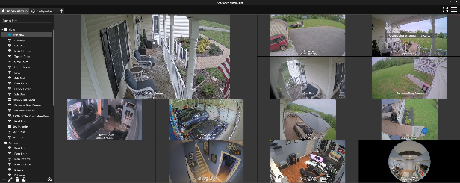
Unleashing the Power of Smart Home Security
Notes:
Key components and features of smart home security systems typically include:
Smart Cameras, Smart Locks, Doorbell Cameras/Video Intercom, Motion Sensors, Mobile and Remote Access, and last but not least IP Audio devices.
Smart Cameras: These include indoor and outdoor cameras that can stream live video, record footage, and send alerts when motion is detected. Some cameras have advanced features like facial recognition, night vision, and two-way audio.
Smart Locks: These electronic locks can be controlled remotely via a smartphone app, allowing homeowners to lock or unlock doors from anywhere. They often integrate with other smart home devices and can provide temporary access codes for guests.
Doorbell Cameras/Video Intercom: Equipped with video and audio capabilities, these devices allow homeowners to see and speak to visitors at their door via their smartphones. They can also record video and send alerts when someone approaches the door.
Motion Sensors: These devices detect movement within a specified range and can trigger alarms or notifications. They are often used to monitor entry points or sensitive areas inside the home.
Window and Door Sensors: These sensors detect when a window or door is opened or closed and can send alerts to the homeowner. They are essential for securing entry points against unauthorized access.
Smart Alarms: These are integrated alarm systems that can be controlled via a smartphone app. They can include sirens, lights, and notifications to alert homeowners of potential intrusions.
Smart Lighting: Automated lighting systems can be programmed to turn on or off at certain times or in response to motion, deterring potential intruders by simulating occupancy.
Security Hubs and Control Panels: These serve as the central control units for all connected security devices, allowing for easy management and monitoring. They can be integrated with voice assistants like Amazon Alexa or Google Assistant for voice control.
Environmental Sensors: These include smoke detectors, carbon monoxide detectors, and water leak sensors, which can alert homeowners to potential hazards beyond security threats.
Mobile and Remote Access: Smart home security systems offer mobile apps that allow homeowners to monitor and control their security devices remotely, receive real-time alerts, and review security footage.
The main advantages of smart home security systems are:
Enhanced Security: Real-time monitoring and alerts ensure that homeowners are immediately informed of any suspicious activity.
Convenience: Remote access and automation features make managing home security more straightforward and flexible.
Integration: Smart home security systems can often be integrated with other smart home devices, creating a cohesive and automated home environment.
Customization: These systems are highly customizable, allowing homeowners to choose the devices and features that best suit their needs.
Smart home security represents a significant advancement in residential safety, offering improved protection and peace of mind through the use of modern technology.

Slide 12
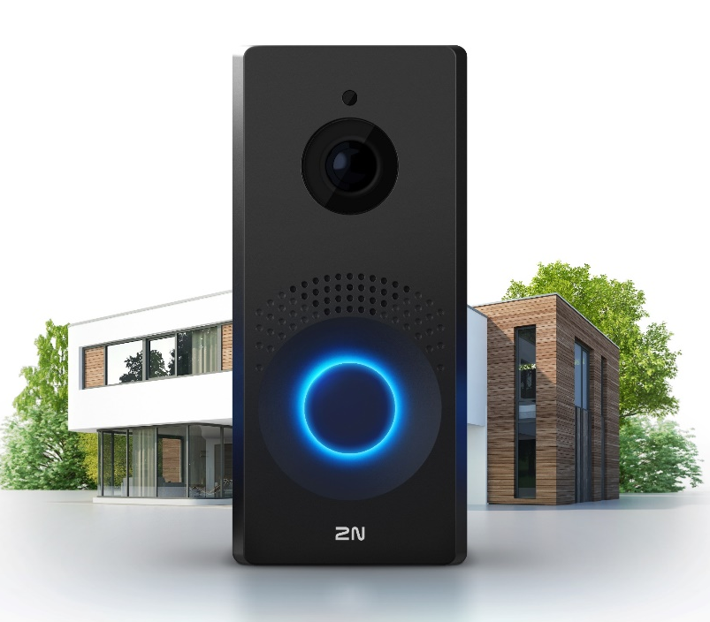
Video Intercom
history
Notes:
The first video doorbell for residential homes was created by inventor Marie Van Brittan Brown in 1966. She patented an early version of a home security system, which included a video surveillance system. Her design featured a camera that could slide up and down to view through a peephole, a monitor inside the house, a two-way microphone, and a remote-controlled door lock. Brown's invention laid the groundwork for modern video doorbells and other home security systems, emphasizing the importance of home security and remote monitoring long before the advent of today's smart home technology.

Slide 13
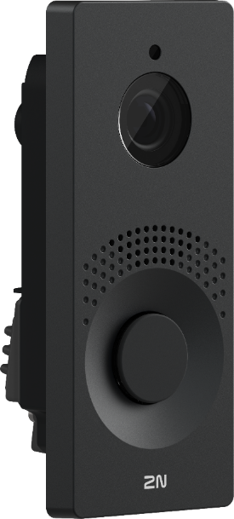
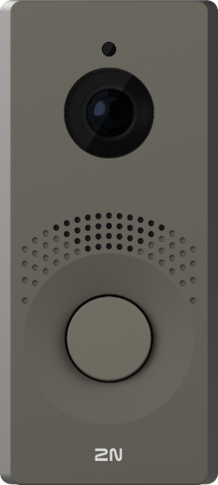
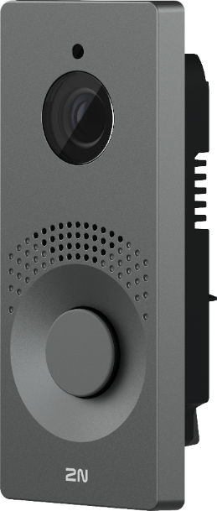
Video Intercom
Notes:
The first IP video intercom was introduced back in 2008 by 2N, which unleashed smart homes' capability to another level by not only introducing an IP product but also allowing smart homes to interconnect multiple systems and products, creating a full security solution for the residential market.

Slide 14
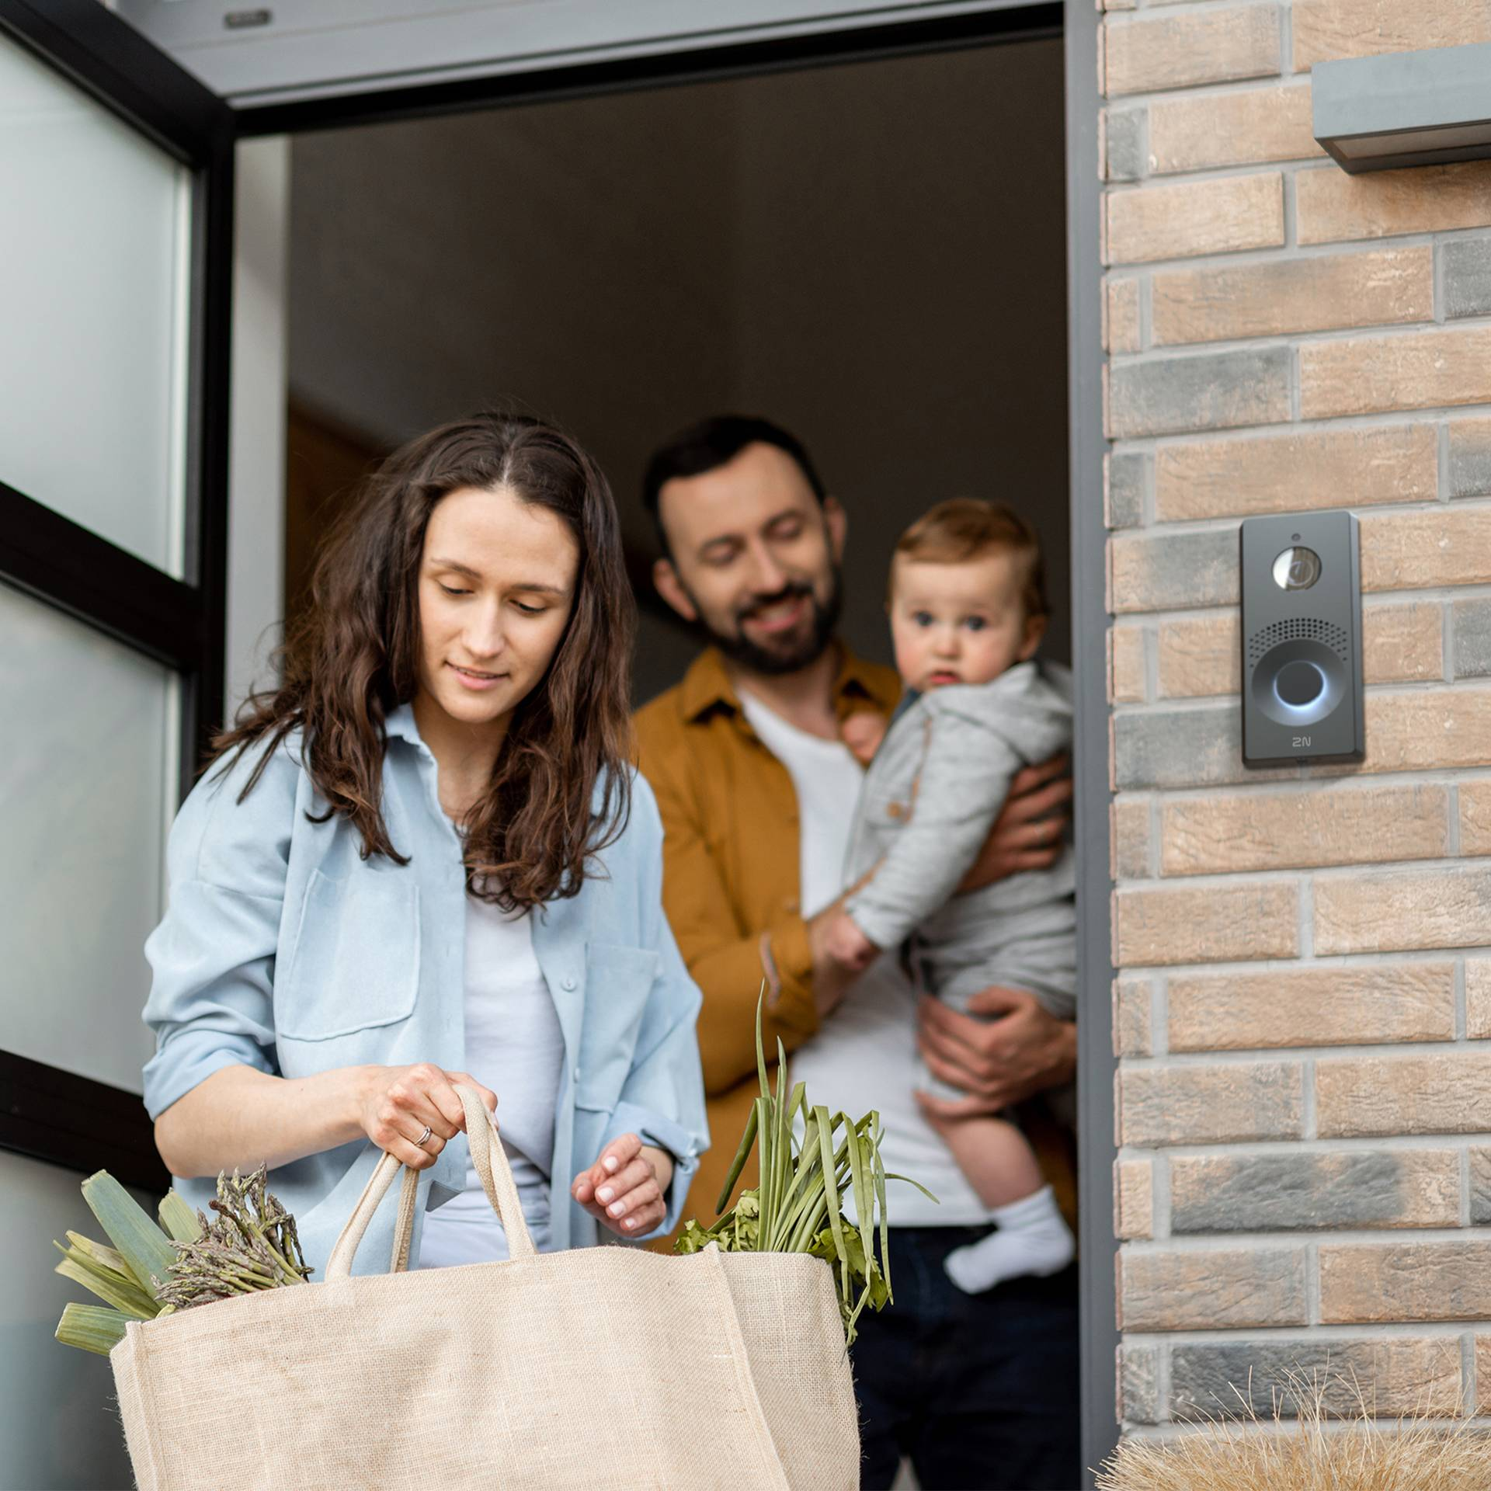
Video Intercom
Notes:
So why do I believe a video intercom is the first step to securing your home?
A video intercom is a good start to creating a smart home security system for several reasons:
1. **Enhanced Visitor Screening**: With a video intercom, you can see and communicate with visitors before granting them access to your home. This added layer of security helps prevent unwanted or suspicious individuals from entering.
2. **Remote Access**: Many video intercom systems allow you to view and communicate with visitors remotely via a smartphone app. This is especially useful when you are not at home, providing peace of mind and the ability to manage access from anywhere.
3. **Integration with Other Smart Devices**: Video intercoms can be integrated with other smart home devices, such as smart locks, security cameras, and alarm systems. This creates a cohesive security network, enhancing overall home security.
4. **Record and Monitor Activity**: Video intercoms often come with recording capabilities, allowing you to monitor and review footage of visitors. This can be useful for security investigations or simply to keep track of who has visited your home.
5. **Deterrent Effect**: The presence of a video intercom can act as a deterrent to potential intruders, who are less likely to attempt entry if they know they are being monitored.
6. **Convenience and Safety**: Video intercoms provide a convenient and safe way to communicate with visitors without having to open the door. This is particularly beneficial for vulnerable individuals, such as the elderly or those living alone.
7. **User-Friendly**: Modern video intercom systems are typically easy to install and use, making them an accessible starting point for homeowners looking to enhance their security without requiring extensive technical knowledge.
Overall, a video intercom system is an effective and practical first step in building a comprehensive smart home security solution.

Slide 15
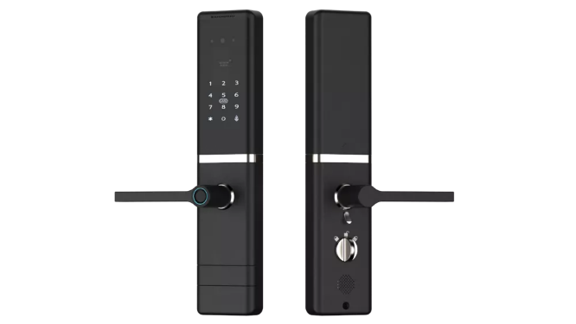
Smart Locks
Notes:
Smart locks and video intercoms can work together seamlessly to enhance home security and provide convenient access control. Here's how they typically integrate:
1. **Unified Control via Smartphone App**:
- Both smart locks and video intercoms can be controlled through a single smartphone app. This integration allows homeowners to see who is at their door through the video intercom and then unlock the door remotely if desired.
2. **Real-Time Notifications and Remote Access**:
- When a visitor presses the video intercom, the homeowner receives a real-time notification on their smartphone. They can view the live video feed, communicate with the visitor, and, if necessary, unlock the smart lock remotely, all from the same app.
3. **Automated Actions**:
- Advanced systems allow for automated actions based on specific triggers. For example, when the video intercom detects motion or a visitor, it can automatically activate the smart lock to prepare for potential access control actions.
- Some systems can also lock the door automatically after a certain period or when the homeowner leaves the house, ensuring the home is always secure.
4. **Access Logs and Monitoring**:
- Both devices can maintain logs of access attempts and interactions. The video intercom records video and audio of each visitor, while the smart lock records when and by whom it was locked or unlocked. This provides a comprehensive security log that can be reviewed if necessary.
5. **Guest Access Management**:
- Homeowners can use the combined system to provide temporary access codes for guests, delivery personnel, or service providers. The video intercom ensures the homeowner can verify the visitor's identity before granting access through the smart lock.
6. **Voice Assistant Integration**:
- Many smart locks and video intercoms integrate with voice assistants like Amazon Alexa, Google Assistant, or Apple Siri. Homeowners can use voice commands to check who is at the door via the intercom and unlock the door if needed.
7. **Enhanced Security Protocols**:
- The combination of both devices can offer enhanced security protocols. For instance, two-factor authentication can be used where the video intercom verifies the visitor's identity, and the smart lock grants access only if the visitor meets specific criteria set by the homeowner.
8. **Emergency Situations**:
- In case of emergencies, homeowners can quickly communicate with visitors or emergency personnel via the video intercom and unlock the door remotely to provide access without needing to physically be at the door.
By integrating smart locks with video intercoms, homeowners achieve a higher level of security and convenience, providing better control over who enters their home and when. This integration represents a significant advancement in smart home technology, offering peace of mind and streamlined access management.

Slide 16
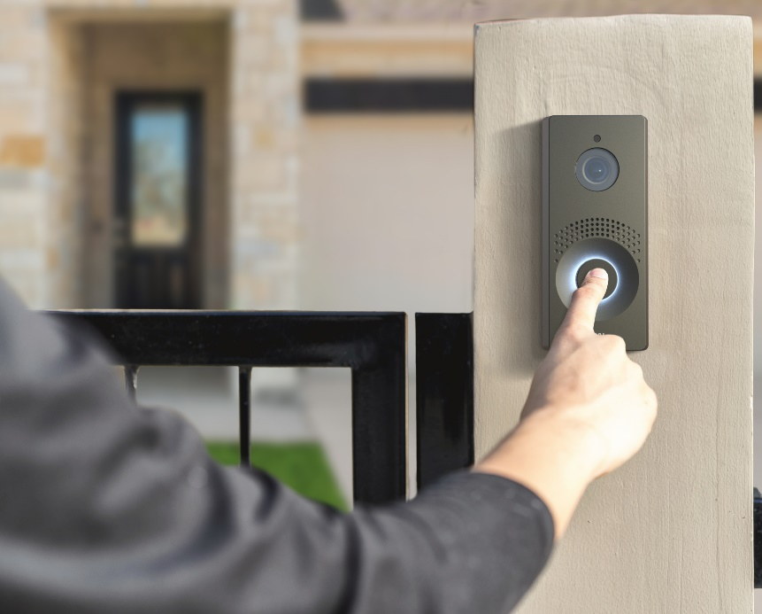
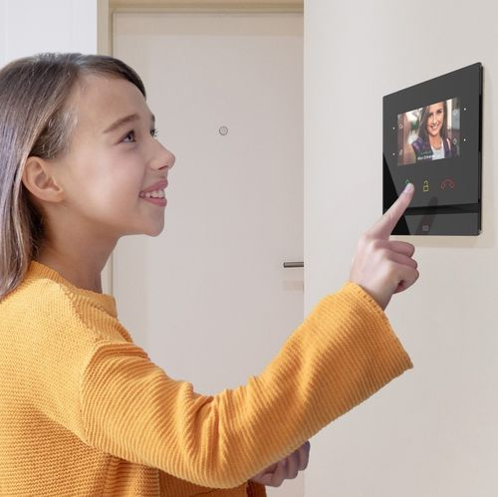
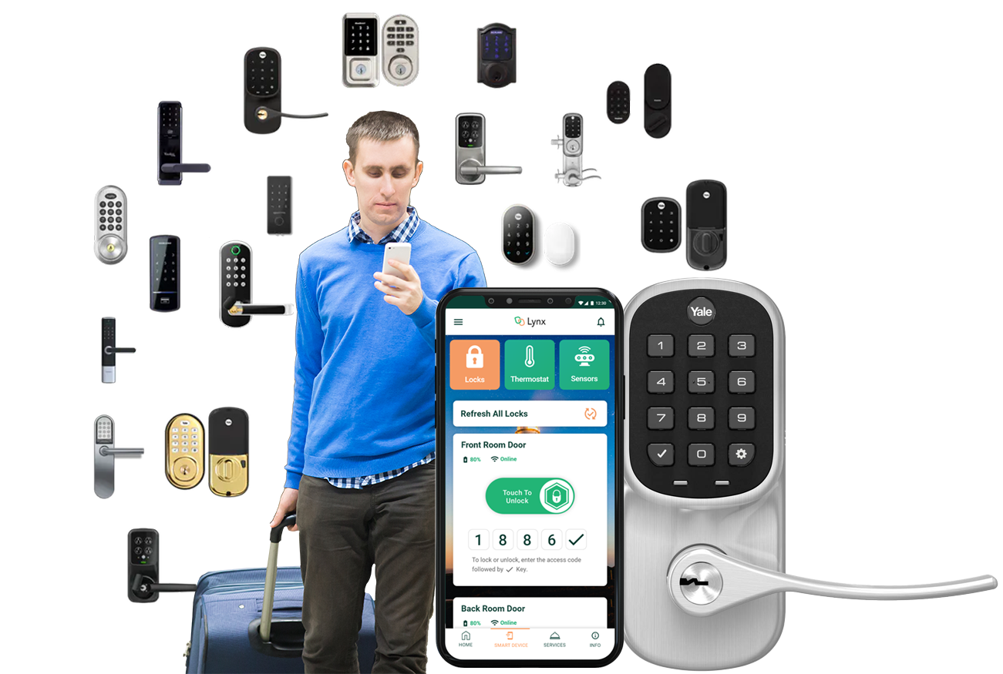
Scenario
Notes:
How does it work?
A person comes to the house and presses the video intercom button. A call is started. The person inside the home at that point can choose to answer the call or ignore it. In this case, they answer the call and choose to unlock the door either via a mobile app or, in this case, an internal video monitor. Once they press the lockset button, it unlocks the door, allowing the person to come in.

Slide 17
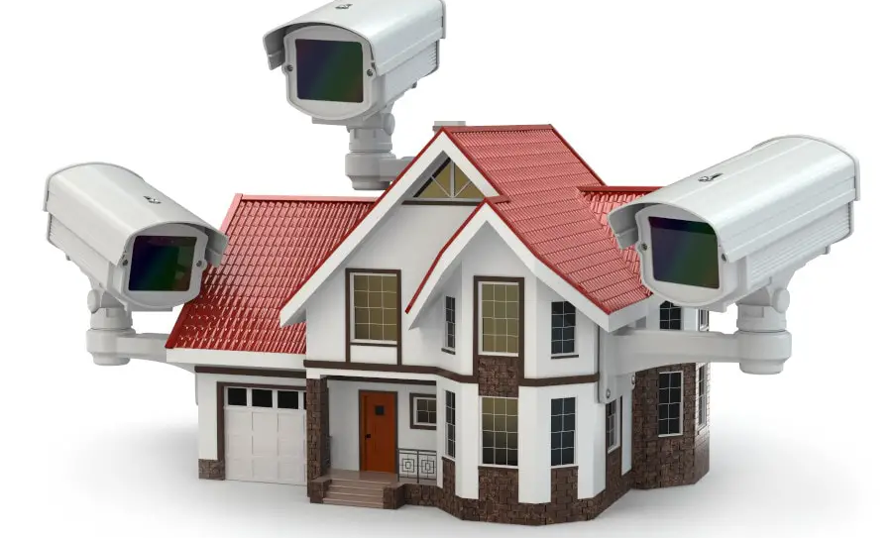
IP Video Cameras
and video analytics
Notes:
IP video cameras, IP intercom systems, and smart wireless locks can work together seamlessly to provide enhanced security and convenience for residential or commercial spaces. Here's how they typically integrate:
1. **IP Video Cameras**: IP cameras are connected to the local network or the internet, allowing users to monitor their surroundings remotely through a smartphone, tablet, or computer. They provide live video feeds and recordings of the area they cover.
2. **IP Intercom Systems**: IP intercom systems enable communication between individuals at the door and those inside the premises. When someone rings the doorbell or activates the intercom, a notification is sent to connected devices, such as smartphones or tablets. Users can then see and communicate with the visitor through audio and video feeds.
3. **Smart Wireless Locks**: Smart locks are electronic locks that can be locked and unlocked remotely using a smartphone app or a web interface. They eliminate the need for physical keys and allow users to grant access to others without being present physically.
Integration:
- When a visitor approaches the door, the IP video camera detects motion or captures their presence.
- The IP intercom system notifies the occupants inside the premises about the visitor's presence, allowing them to see and communicate with the visitor remotely.
- Using the intercom system or the smartphone app connected to the smart wireless lock, the occupants can grant access to the visitor if deemed appropriate.
- Once permission is granted, the smart lock is remotely unlocked, allowing the visitor to enter the premises.
In summary, these systems work together to provide a comprehensive security solution that allows users to monitor, communicate with, and grant access to visitors remotely, enhancing both security and convenience.

Slide 18
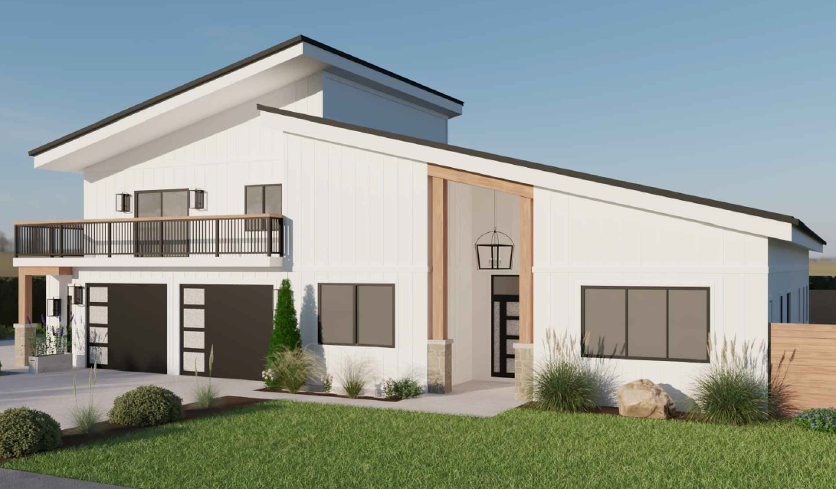
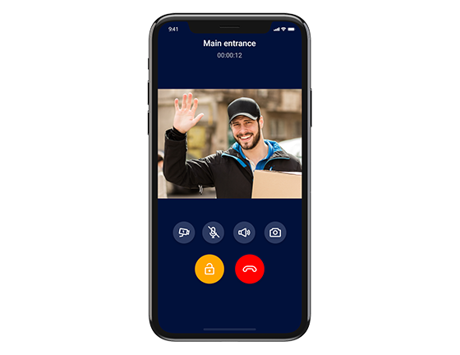
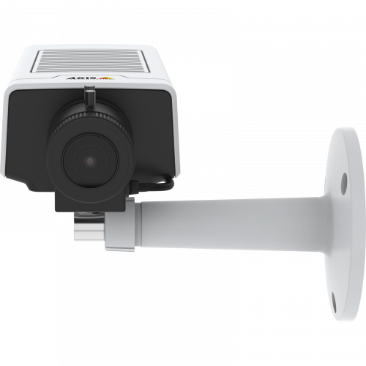
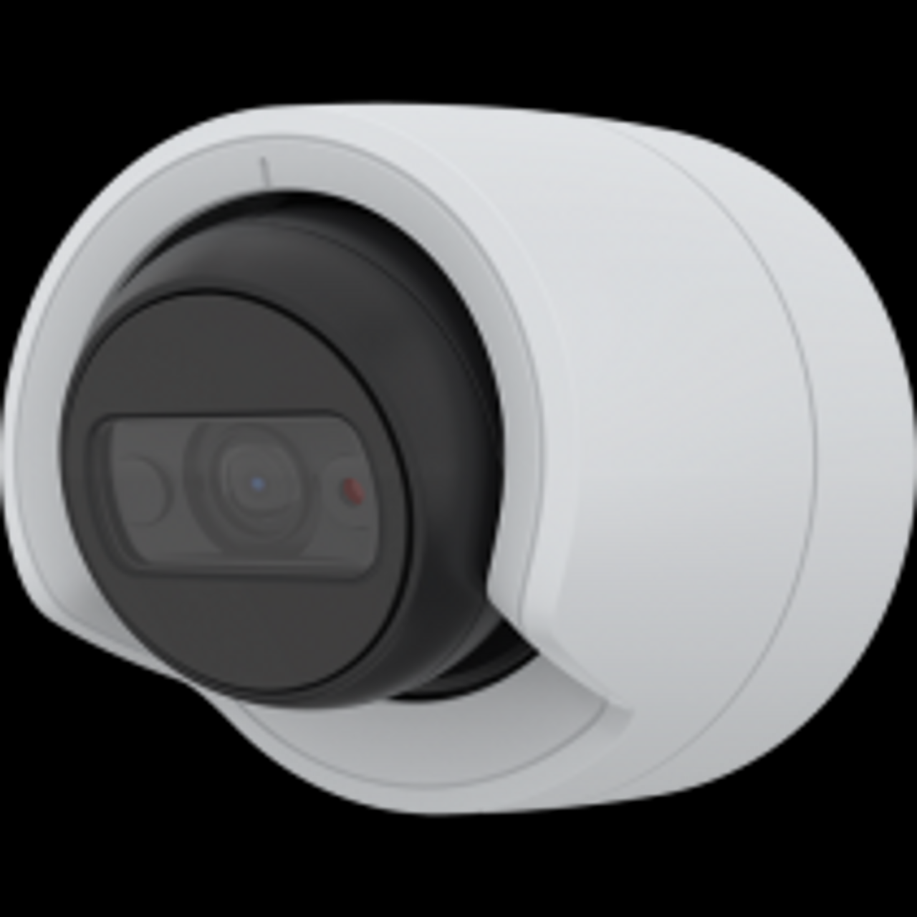
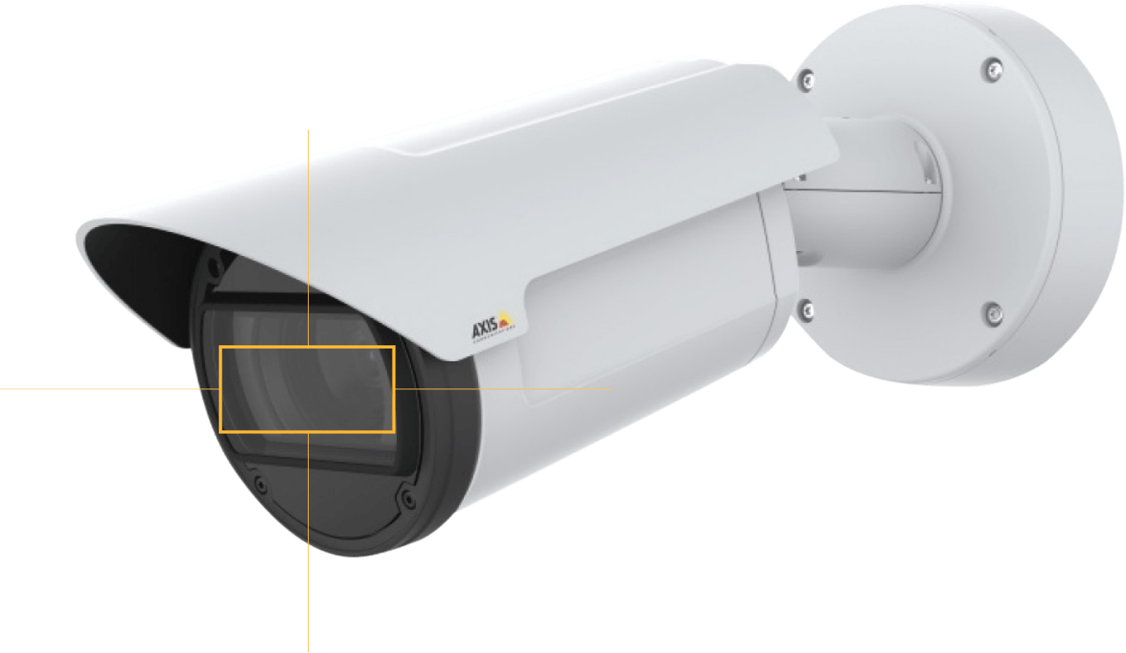
Smart Home Security Solutions
Motion
Notes:
Examples 1

Slide 19
Smart Home Security Solutions
Notes:
Examples 2

Slide 20
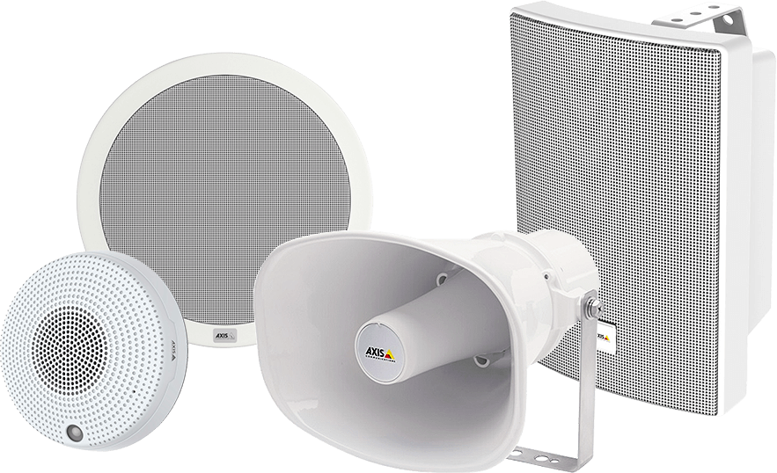
IP Audio
Notes:
Integrating an IP speaker into a residential home security system can enhance communication and deterrence capabilities. Here’s how an IP speaker can be integrated and used within such a system:

Slide 21
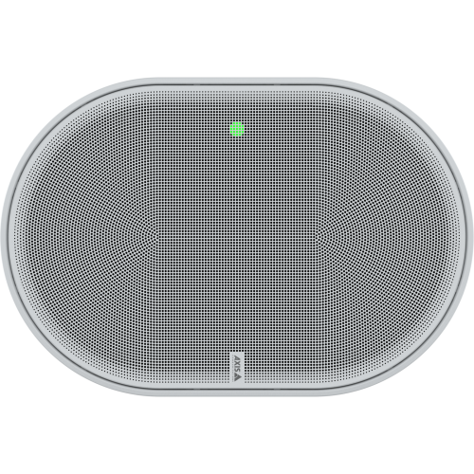
Smart Home Security Solutions
Camera detects human
Notes:
### Integration Steps:
1. **Network Setup**:
- **Connect to Network**: Connect the IP speaker to your home network via Ethernet or Wi-Fi.
- **Assign IP Address**: Assign a static IP address to the speaker to ensure it is easily identifiable and accessible on the network.
2. **Home Security System Integration**:
- **Compatibility Check**: Ensure that the IP speaker is compatible with your home security system. Many modern systems support integration with networked devices.
- **System Configuration**: Use the security system’s control panel or software to add the IP speaker. This may involve entering the speaker's IP address and configuring communication protocols.
3. **Software Integration**:
- **Use Security System App**: If your security system comes with a mobile or desktop app, ensure that the app can control and communicate with the IP speaker.
- **Automation Setup**: Set up automation rules, such as triggering the speaker to play a pre-recorded message or alert sound when a security sensor is activated (e.g., door/window sensors, motion detectors).
### Usage Scenarios:
1. **Intruder Deterrence**:
- **Alarm Announcements**: The IP speaker can play loud alarm sounds or verbal warnings when an intrusion is detected.
- **Live Communication**: Use the speaker to communicate with intruders remotely, warning them that they are being monitored and that authorities have been notified.
2. **Emergency Announcements**:
- **Broadcast Alerts**: In case of emergencies (fire, gas leak, etc.), the IP speaker can broadcast evacuation instructions or other critical information to occupants.
3. **Two-Way Communication**:
- **Intercom Functionality**: Use the IP speaker as part of an intercom system to communicate with family members in different parts of the house.
- **Remote Assistance**: Communicate with family members or visitors remotely via the security system’s app.
4. **Routine Announcements**:
- **Scheduled Announcements**: Use the IP speaker to make routine announcements, such as reminders or notifications about security system status (e.g., arming/disarming the system).
5. **Integration with Other Smart Home Devices**:
- **Smart Home Ecosystem**: Integrate the IP speaker with other smart home devices, such as smart lights, cameras, and sensors, to create a comprehensive and automated security and home management system.
### Benefits:
- **Enhanced Security**: Immediate audio alerts and the ability to communicate directly with intruders or occupants.
- **Convenience**: Easy communication within the household.
- **Flexibility**: Can be used for multiple purposes beyond security, such as routine announcements and smart home integrations.
- **Scalability**: Easy to add more speakers or integrate with other smart devices as needed.
### Considerations:
- **Network Reliability**: Ensure a stable and secure network connection to avoid disruptions.
- **Power Supply**: Ensure the speaker has a reliable power source, or consider models with battery backup in case of power outages.
- **Privacy**: Be mindful of privacy concerns and ensure that the IP speaker is securely configured to prevent unauthorized access.
By following these steps and considerations, an IP speaker can be a valuable addition to a residential home security system, enhancing both security and communication capabilities.

Slide 22
Smart Home Security Solutions
Camera send owner an alert
Notes:
### Integration Steps:
1. **Network Setup**:
- **Connect to Network**: Connect the IP speaker to your home network via Ethernet or Wi-Fi.
- **Assign IP Address**: Assign a static IP address to the speaker to ensure it is easily identifiable and accessible on the network.
2. **Home Security System Integration**:
- **Compatibility Check**: Ensure that the IP speaker is compatible with your home security system. Many modern systems support integration with networked devices.
- **System Configuration**: Use the security system’s control panel or software to add the IP speaker. This may involve entering the speaker's IP address and configuring communication protocols.
3. **Software Integration**:
- **Use Security System App**: If your security system comes with a mobile or desktop app, ensure that the app can control and communicate with the IP speaker.
- **Automation Setup**: Set up automation rules, such as triggering the speaker to play a pre-recorded message or alert sound when a security sensor is activated (e.g., door/window sensors, motion detectors).
### Usage Scenarios:
1. **Intruder Deterrence**:
- **Alarm Announcements**: The IP speaker can play loud alarm sounds or verbal warnings when an intrusion is detected.
- **Live Communication**: Use the speaker to communicate with intruders remotely, warning them that they are being monitored and that authorities have been notified.
2. **Emergency Announcements**:
- **Broadcast Alerts**: In case of emergencies (fire, gas leak, etc.), the IP speaker can broadcast evacuation instructions or other critical information to occupants.
3. **Two-Way Communication**:
- **Intercom Functionality**: Use the IP speaker as part of an intercom system to communicate with family members in different parts of the house.
- **Remote Assistance**: Communicate with family members or visitors remotely via the security system’s app.
4. **Routine Announcements**:
- **Scheduled Announcements**: Use the IP speaker to make routine announcements, such as reminders or notifications about security system status (e.g., arming/disarming the system).
5. **Integration with Other Smart Home Devices**:
- **Smart Home Ecosystem**: Integrate the IP speaker with other smart home devices, such as smart lights, cameras, and sensors, to create a comprehensive and automated security and home management system.
### Benefits:
- **Enhanced Security**: Immediate audio alerts and the ability to communicate directly with intruders or occupants.
- **Convenience**: Easy communication within the household.
- **Flexibility**: Can be used for multiple purposes beyond security, such as routine announcements and smart home integrations.
- **Scalability**: Easy to add more speakers or integrate with other smart devices as needed.
### Considerations:
- **Network Reliability**: Ensure a stable and secure network connection to avoid disruptions.
- **Power Supply**: Ensure the speaker has a reliable power source, or consider models with battery backup in case of power outages.
- **Privacy**: Be mindful of privacy concerns and ensure that the IP speaker is securely configured to prevent unauthorized access.
By following these steps and considerations, an IP speaker can be a valuable addition to a residential home security system, enhancing both security and communication capabilities.

Slide 23
Smart Home Security Solutions
The camera triggers a message sent to the IP speaker to deter the intruder.
Notes:
### Integration Steps:
1. **Network Setup**:
- **Connect to Network**: Connect the IP speaker to your home network via Ethernet or Wi-Fi.
- **Assign IP Address**: Assign a static IP address to the speaker to ensure it is easily identifiable and accessible on the network.
2. **Home Security System Integration**:
- **Compatibility Check**: Ensure that the IP speaker is compatible with your home security system. Many modern systems support integration with networked devices.
- **System Configuration**: Use the security system’s control panel or software to add the IP speaker. This may involve entering the speaker's IP address and configuring communication protocols.
3. **Software Integration**:
- **Use Security System App**: If your security system comes with a mobile or desktop app, ensure that the app can control and communicate with the IP speaker.
- **Automation Setup**: Set up automation rules, such as triggering the speaker to play a pre-recorded message or alert sound when a security sensor is activated (e.g., door/window sensors, motion detectors).
### Usage Scenarios:
1. **Intruder Deterrence**:
- **Alarm Announcements**: The IP speaker can play loud alarm sounds or verbal warnings when an intrusion is detected.
- **Live Communication**: Use the speaker to communicate with intruders remotely, warning them that they are being monitored and that authorities have been notified.
2. **Emergency Announcements**:
- **Broadcast Alerts**: In case of emergencies (fire, gas leak, etc.), the IP speaker can broadcast evacuation instructions or other critical information to occupants.
3. **Two-Way Communication**:
- **Intercom Functionality**: Use the IP speaker as part of an intercom system to communicate with family members in different parts of the house.
- **Remote Assistance**: Communicate with family members or visitors remotely via the security system’s app.
4. **Routine Announcements**:
- **Scheduled Announcements**: Use the IP speaker to make routine announcements, such as reminders or notifications about security system status (e.g., arming/disarming the system).
5. **Integration with Other Smart Home Devices**:
- **Smart Home Ecosystem**: Integrate the IP speaker with other smart home devices, such as smart lights, cameras, and sensors, to create a comprehensive and automated security and home management system.
### Benefits:
- **Enhanced Security**: Immediate audio alerts and the ability to communicate directly with intruders or occupants.
- **Convenience**: Easy communication within the household.
- **Flexibility**: Can be used for multiple purposes beyond security, such as routine announcements and smart home integrations.
- **Scalability**: Easy to add more speakers or integrate with other smart devices as needed.
### Considerations:
- **Network Reliability**: Ensure a stable and secure network connection to avoid disruptions.
- **Power Supply**: Ensure the speaker has a reliable power source, or consider models with battery backup in case of power outages.
- **Privacy**: Be mindful of privacy concerns and ensure that the IP speaker is securely configured to prevent unauthorized access.
By following these steps and considerations, an IP speaker can be a valuable addition to a residential home security system, enhancing both security and communication capabilities.

Slide 24
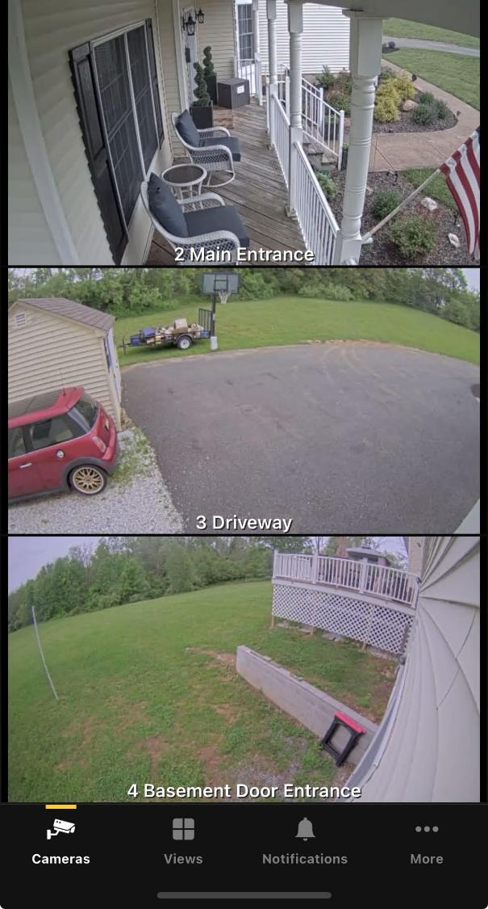
Smart Home Security Solutions
Video Intercoms
Video Analytics
Full Residential Security Solution
IP Cameras
Remote Monitoring
Home Automation
Notes:
Combining IP video intercoms, IP cameras, wireless locksets, and IP audio devices in a residential security system offers comprehensive benefits by creating a fully integrated, smart security solution. Here's how each component contributes to the overall system:
1. **IP Video Intercoms**:
- **Enhanced Communication**: Allows homeowners to see and communicate with visitors at the door, enhancing safety and convenience.
- **Remote Access**: Enables remote interaction through mobile apps, allowing you to manage visitors even when you are not home.
2. **IP Cameras**:
- **Real-Time Monitoring**: Provides live video feeds of various areas around the home, allowing for real-time surveillance.
- **Evidence Collection**: Records footage that can be used as evidence in case of incidents, improving security and accountability.
3. **Wireless Locksets**:
- **Remote Lock/Unlock**: Allows homeowners to lock or unlock doors remotely, providing flexibility and control over home access.
- **Access Logs**: Tracks entry and exit times, enhancing security by keeping detailed access records.
4. **IP Audio Devices**:
- **Intruder Deterrence**: Plays alarm sounds or verbal warnings to deter intruders, adding an audible layer of security.
### Integrated System Benefits:
- **Seamless Operation**: All components work together, providing a cohesive security system where each device enhances the functionality of the others.
- **Enhanced Security**: Real-time video and audio monitoring, combined with remote access control, significantly improve the ability to detect and respond to security threats.
- **Convenience**: Integrated controls through a single app or platform streamline management, making it easier to monitor and secure your home from anywhere.
- **Smart Automation**: Allows for the creation of automated security routines, such as locking doors and activating cameras when the security system is armed.
- **Improved Response**: Faster and more informed responses to security events due to the availability of real-time data and communication tools.
Overall, integrating IP video intercoms, IP cameras, wireless locksets, and IP audio devices creates a robust and interconnected residential security system that enhances safety, convenience, and peace of mind.

Slide 25
THANK YOU!
Questions?

Slide 26
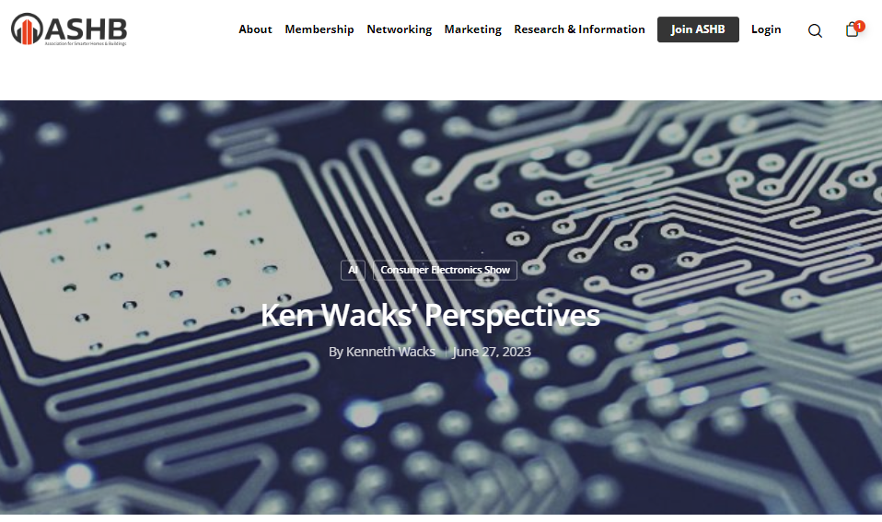
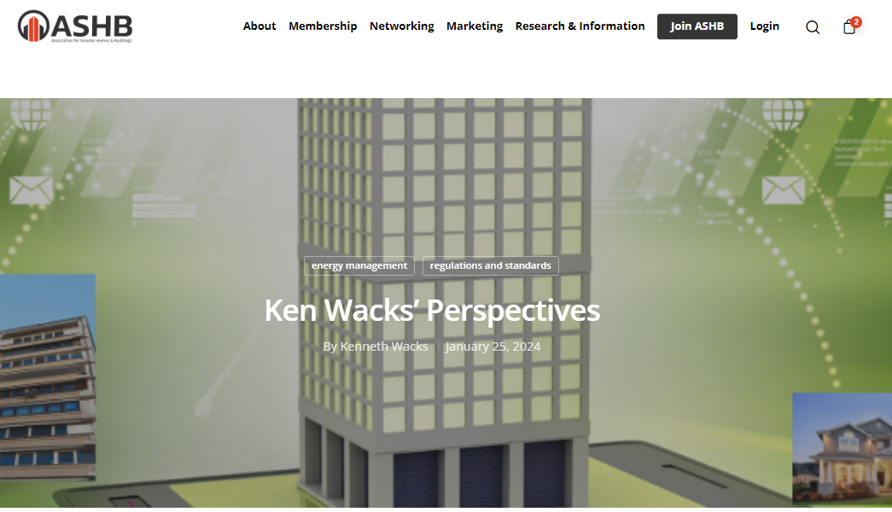
6. ASHB Journal Ken Wacks (Ken Wacks Associates)
The ASHB Journal aims to educate and inform the ASHB membership and industry at large on emerging research, issues, challenges, and opportunities in the intelligent buildings and/or connected home sectors.
New articles are posted to the ASHB website, included in the weekly NewsBrief, and circulated on Twitter and LinkedIn.
Send proposals to admin@ashb.com
Recent posts:
Ken Wacks Perspectives: The Business Case for Energy Management
Ken Wacks Perspectives: CES 2023: A Sampling of Product Diversity
Facilio: The Relevance of Decarbonizing Goals During the Downturn
26

Slide 27
7. ASHB Whitepapers Ken Wacks (Ken Wacks Associates)
Published IBC White Papers can be downloaded at:
ashb.com/whitepapers
Send proposals to admin@ashb.com

Slide 28
7. ASHB Whitepapers Ken Wacks (Ken Wacks Associates)
Call for Whitepaper Working Group Members
Overview:
Leadership: Jerry Overton of appliedAIstudio
Whitepaper Title: AI-Powered Smart Homes: Revolutionizing Caregiving for Aging and Disabilities - Insights from an Industry Working Group
Goal: Explore innovative AI solutions to enhance safety and support for the elderly and disabled in their homes.
Abstract:
Urgent need for AI-powered smart home solutions tailored for aging and disabled individuals.
Emphasis on collaborative efforts to fill market gaps in accessibility, usability, and affordability.
Development of inclusive and innovative solutions.
Working Group Activities:
Formation and introductory meeting.
Role assignments and research phase initiation.
Market gap analysis and Assessment of existing solutions.
Drafting and refinement of proposed solutions based on stakeholder feedback.
Finalizing the whitepaper and preparing for publication.
Join Us: Interested in participating or need more information? Contact ASHB at admin@ashb.com
Deadline: Respond by May 30, 2024.

Slide 29
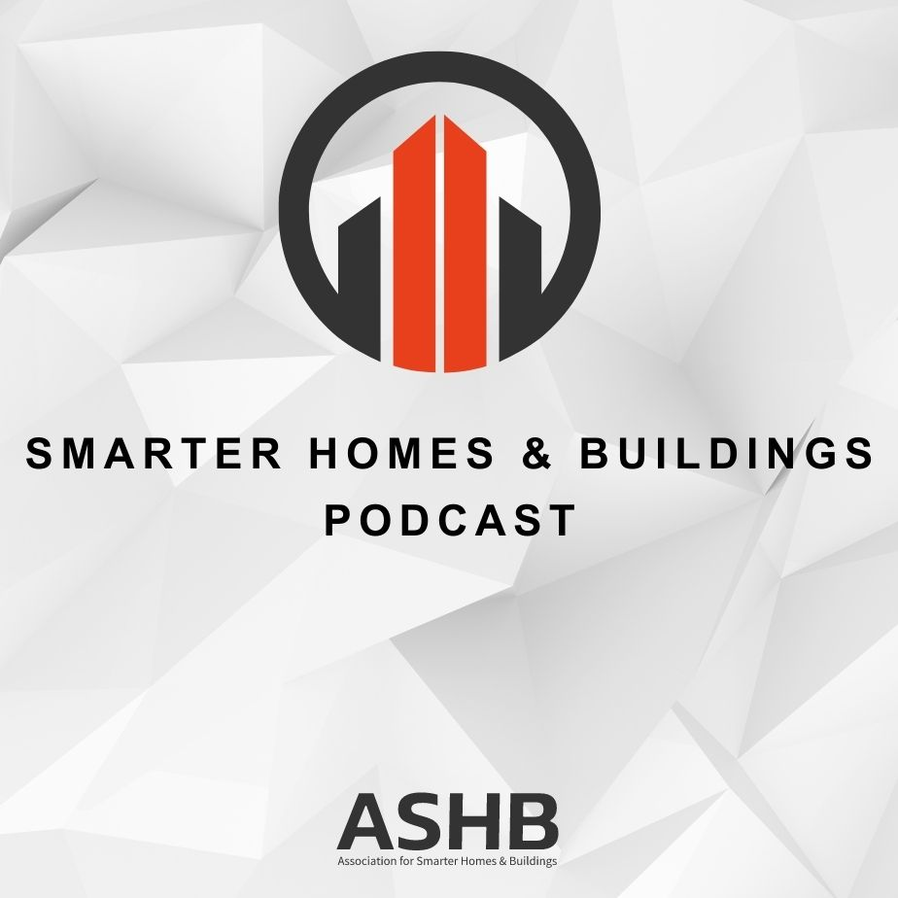
6. Smarter Homes & Buildings Podcast Marta Klopotowska (ASHB)
Join industry experts and leaders from around the globe as they discuss everything smart home and intelligent buildings.
ASHB is looking for guests and hosts for future pre-recorded episodes. Contact admin@ashb.com for more information.
ASHB.COM/PODCAST
Recent Recordings:
Exploring the Evolution and Future of Fire Alarm Systems in Smart Buildings and Homes
Solar Energy is a Team Sport, When OEMs and Installers Collaborate for Quality

Slide 30
9. New Business Ken Wacks (Ken Wacks Associates)
New CHC Business?
30

Slide 31
10. Announcements Charlie Derk (Legrand)
Upcoming Events
Connections (Parks Associates) Virtual Sessions - June 13 & December 12
Shanghai Smart Home Technology
September 3-5 | Shanghai, China
CEDIA Expo
September 5-7 | Denver, CO
Smart Spaces (Parks Associates)
September 24-25 | Richardson, TX
(Virtual - March 21, July 23, December 12)
31

Slide 32
11. Adjournment Ken Wacks (Ken Wacks Associates)
Next CHC Meeting: August 2024
Association for Smarter Homes & Buildings (ASHB) admin@ashb.com | www.ashb.com | www.ashb.com/chc
Connect to what’s next™
32

