Slide 1
Intelligent Buildings Council (IBC)
Chair: Trevor Nightingale (National Research Council)
Vice-Chair: Robert Lane (Robert H. Lane and Associates Inc.)
Vice-Chair: Bob Allan (The Siemon Company)
Vice-Chair: Harsha Chandrashekar (Honeywell International Inc)

Slide 2
Agenda Greg Walker (CABA)
1. Agenda
2. Call to Order, Welcome, Introductions
3. Administrative
“Intelligent Buildings for Occupants, Owners, and Operators: A Consultant’s PerspectiveIoT in the Enterprise” (30 min)
5. Research Update
6. White Paper Sub-Committee Update
7. New Business
8. Announcements
9. Adjournment

Slide 3
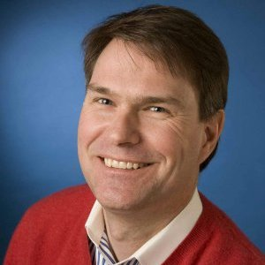
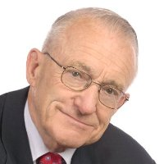
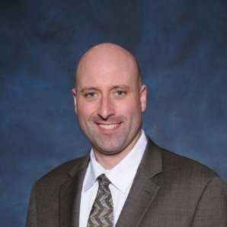
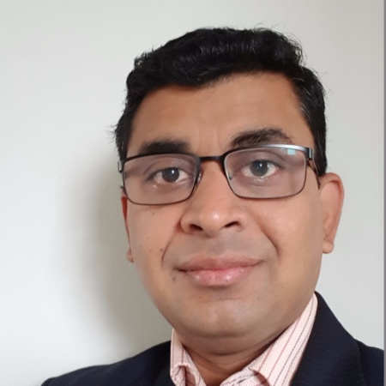
2. Call to Order, Welcome, Introductions – About the IBC Trevor Nightingale (National Research Council)
IBC Vice-Chair
Trevor Nightingale
Director
National Research Council
IBC Vice-Chair
Robert Lane
President & Managing Partner
Robert H. Lane and Associates Inc.
IBC Vice-Chair
Bob Allan
Product Marketing Manager
The Siemon Company
IBC Vice-Chair
Harsha Chandrashekar
Product Approvals & Regulatory Leader
Honeywell International Inc
The CABA Intelligent Buildings Council works to strengthen the large building automation industry through innovative technology-driven research projects. The Council was established in 2001 by CABA to specifically review opportunities, take strategic action and monitor initiatives that relate to integrated systems and automation in the large building sector. The Council's projects promote the next generation of intelligent building technologies and incorporates a holistic approach that optimizes building performance and savings.
http://www.caba.org/IBC

Slide 4
3. Administrative Trevor Nightingale (National Research Council)
3.1 Motion to approve past IBC Minutes: www.caba.org/IBC

Slide 5
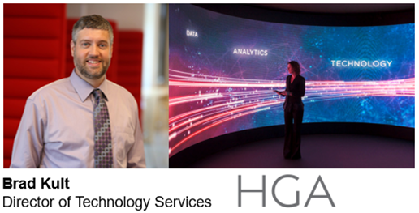
4. “Intelligent Buildings for Occupants, Owners, and Operators: A Consultant’s Perspective” (30 min) Bob Allan (The Siemon Company)

Slide 6
HGA
Integrated Architecture & Engineering
Markets
Public/Corporate
Arts/Culture/Education
Healthcare
National Practice

Slide 7
Full Stack Consulting

Slide 8
Twin Cities Intelligent Buildings Working Group

Slide 9
CABA New Deal Whitepaper
BAS selection and installation is CAPEX, but occupation and operation of the building is OPEX.
Why would owners invest in CAPEX if they don’t get the return from OPEX?

Slide 10
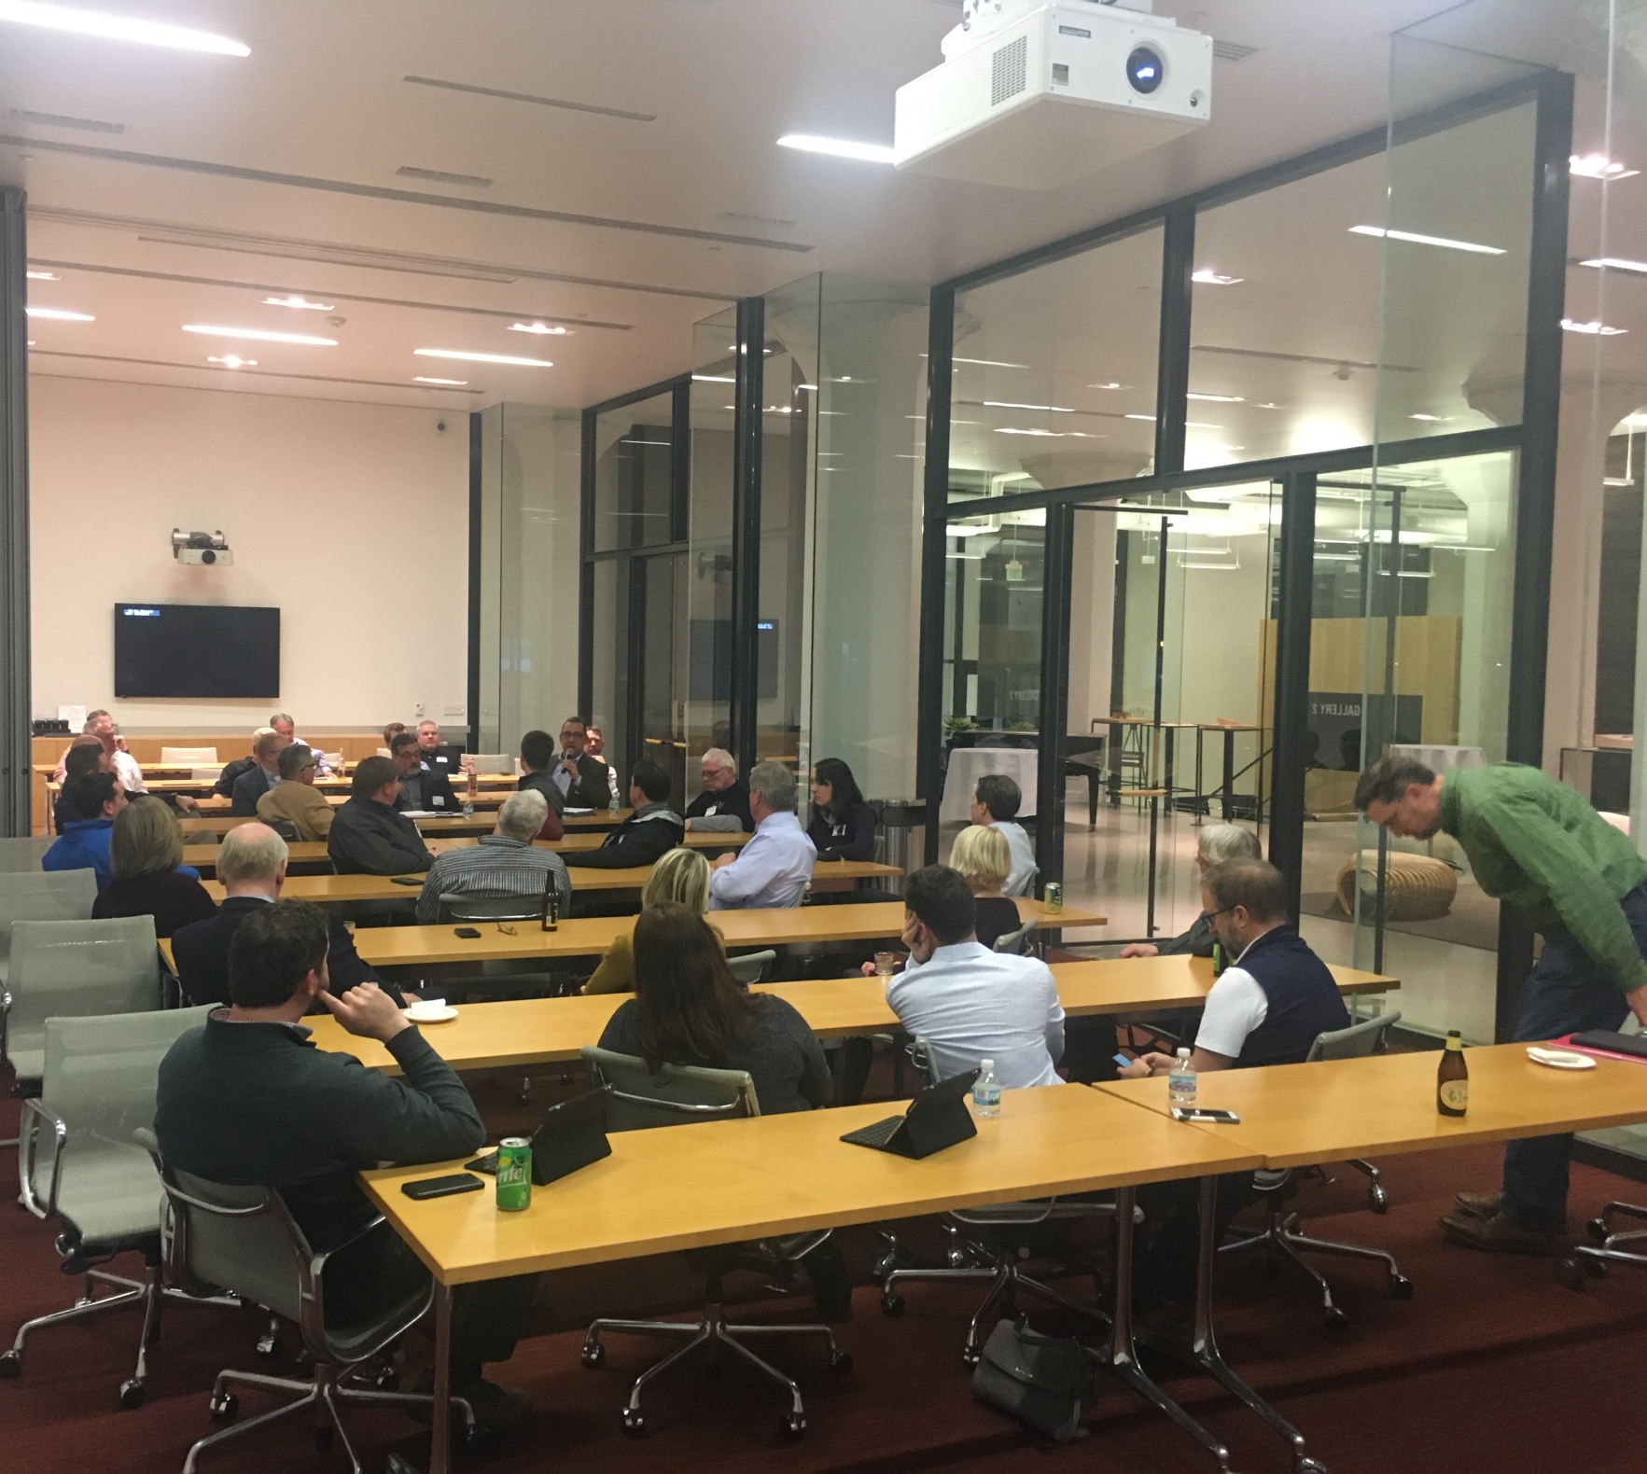
Participants
Contractors
Consultants/Engineers
End Users
Building Operators
Property Managers
Corporate Real Estate
Manufacturers

Slide 11
Steering Committee
Name and Brand
Mission Statement
Charter
Organization Values

Slide 12
Charter
Name and Brand
Mission Statement
Charter
Main Objectives
3-5 Objectives
Organization Values
10-12 Values

Slide 13
Main Objectives
Education & Networking
Cross Disciplinary
Build Demand for Intelligent Buildings
Framework for Project Delivery
End User Choice

Slide 14
Group Values
Value Integrity, Innovation, and Collaboration
Maximize Value to End Users
Favor Open Platforms
Value of Project Teams
Manage Cost
Team Alignment
Coordination
Solutions for Automation and Situational Awareness
Education (Internal & End User)

Slide 15
Meeting Format
Monthly
Networking Hour
Organization Update
Host Presentation
Content
Wrap-Up

Slide 16
Communication Tools
Email
Meeting Invites
Post-Meeting Notes
Google Docs
Slack Page

Slide 17
Question and Answer

Slide 18
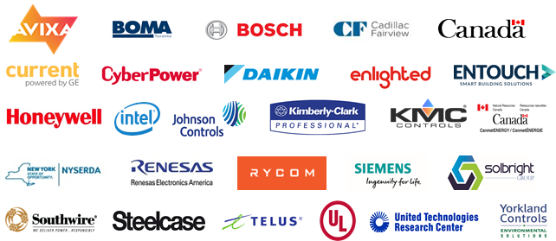
5. Research Update Harsha Chandrashekar (Honeywell International Inc.)
5.1 “Intelligent Building Design & Implementation”
www.caba.org/Research

Slide 19
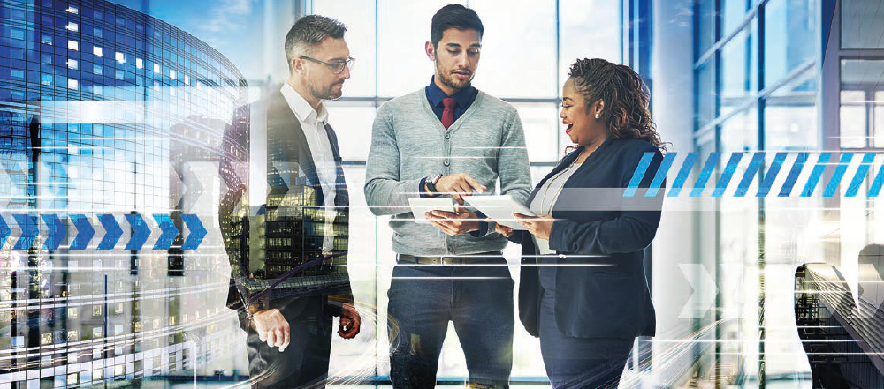
5. Research Update Trevor Nightingale (National Research Council)
5.2 “Phase 2: Improving Organizational Productivity with Building Automation Systems”
Free Download of Phase 1: www.caba.org/productivity

Slide 20
5. Research Update Harsha Chandrashekar (Honeywell International Inc.)
5.3 “Monetization of Intelligent Buildings”
www.caba.org/Research

Slide 21
6. White Paper Sub-Committee Update Ken Wacks (Ken Wacks Associates)
6.1 Recently Completed:
“Creating a New Deal for Buildings”
Buildingcontext.me
Cimetrics, Inc.
Fulham Co., Inc.
Honeywell International Inc.
Johnson Controls Inc.
LonMark International
SkyFoundry, LLC
Sustainable Resources Management Inc.
Yorkland Controls Limited
www.caba.org/WhitePapers

Slide 22
6. White Paper Sub-Committee Update Ken Wacks (Ken Wacks Associates)
6.1 Recently Completed:
“Probable Elevator Systems in Future Intelligent Buildings”
Part 1: Speed of Multi-dimensionality
Part 2: Remote Control and Monitoring and Emergency Operation
Part 3: Dispatchers and Energy Conservation
International Association of Elevator Engineers
The University of Northampton
www.caba.org/WhitePapers

Slide 23
6. White Paper Sub-Committee Update Ken Wacks (Ken Wacks Associates)
6.2 In Progress:
“Impacts of Automated Shading in Building Projects”
Ecotay Inc.
HunterDouglas
Lawrence Berkeley National Laboratory
MechoSystems, Inc.
NYSERDA
PLC Multipoint, Inc.
Siemens Industry, Inc.
Somfy
Sustainable Resources Management
TRC Energy Services
Vistar Energy Consulting
Window Products Management
www.caba.org/WhitePapers

Slide 24
White Paper Sub-Committee Update Ken Wacks (Ken Wacks Associates)
All proposals and previously completed IBC White Papers can be downloaded at:
www.caba.org/WhitePapers

Slide 25
7. New Business Trevor Nightingale (National Research Council)
7.1 Smart Building Global Competition
- Michael Lake (Leading Cities)
CABA Member, Leading Cities, is a global non-profit and a leader in the Smart Cities space. In June, they will launch their AcceliCity program, a global competition for Smart City startups that includes a web-based curriculum, mentorship, a boot camp in Boston with a pitch day in front of investors and demo day with potential clients. Ultimately, the winners will showcase their solutions in the Leading Cities Pavilion at the Smart City Expo and World Congress in Barcelona—the world’s largest Smart City event.
In this inaugural year, Leading Cities is offering CABA Members free access to host a Smart Challenge. Hosts are able to choose a challenge focus, define the issue and set parameters for solutions, select the winner with inputs from global experts and provide a meaningful prize. Prizes can range from paid pilots, incubation, inclusion in an RFP to full deployment or anything in between.

Slide 26
7. New Business Trevor Nightingale (National Research Council)
7.2 Electronic Systems Professional Alliance
- Jeff Gardner (ESPA)
Electronic Systems Professional Alliance provides training and certification for entry-level technicians. Adopted mainly in high school career centers and tech schools.
Founders include: CEDIA, NSCA, and CTA. Industry partners included ESA, CABA, CompTIA and Bedrock Learning
Participated in CABA education white paper
How You Can Help:
Identify schools in your area who might be a good fit. ESPA can easily be added to existing electronics or IT tracks. Or we can help a school build a complete electronic systems integration program from scratch.
Become an ESPA sponsoring partner with financial support to subsidize exam fees for qualifying students.
Raise awareness in the industry by sharing info via your presentations, newsletters, etc.
For more info: www.espa.org, certification@espa.org

Slide 27
7. New Business Trevor Nightingale (National Research Council)
7.3 New CABA Member Benefit: Dealers, Distributors and Integrators access to CABA Member Research Library
- Andrew Glennie (CABA)

Slide 28
7. New Business Trevor Nightingale (National Research Council)
7.4 Other new IBC business?

Slide 29
8. Announcements Ron Zimmer (CABA)
8.1 Past Event Overview:
Strategies in Light / The LED Show, Feb 13-15, Long Beach, CA
Light + Building, March 18-23, 2018, Frankfurt, Germany
LIGHTFAIR International, May 6-7, Chicago, IL
Innovative Cities Summit 2018, May 9-10, Riyadh, Kingdom of Saudi Arabia
TM FORUM LIVE!, May 14-16, Nice, France

Slide 30
Announcements Ron Zimmer (CABA)
8.2 Upcoming events:
IBcon 2018 – Realcomm, June 6-7, Las Vegas, NV
InfoComm 2018, June 6-8, Las Vegas, NV
2018 NEEP Summit, Oct 2-3, Middletown, RI
interlight MOSCOW, Nov 6-9, Moscow, Russia
Greenbuild International Conference and Expo, Nov 14-16, Chicago, IL
Next IBC Meeting, August 2018

Slide 31
Adjournment Trevor Nightingale (National Research Council)
Continental Automated Buildings Association (CABA) 613.686.1814 Toll free: 888.798.CABA (2222)
caba@caba.org www.CABA.org
www.caba.org/IBC
Connect to what’s next™

