Slide 1
Intelligent Buildings Council (IBC)
Chair: Trevor Nightingale (National Research Council)
Vice-Chair: Robert Lane (Robert H. Lane and Associates Inc.)
Vice-Chair: Bob Allan (The Siemon Company)
Vice-Chair: Harsha Chandrashekar (Honeywell International Inc)

Slide 2
Agenda Greg Walker (CABA)
1. Agenda
2. Call to Order, Welcome, Introductions
3. Administrative
“Buildings Automation Integration” Panel Discussion (30 min)
5. Research Update
6. White Paper Sub-Committee Update
7. New Business
8. Announcements
9. Adjournment

Slide 3
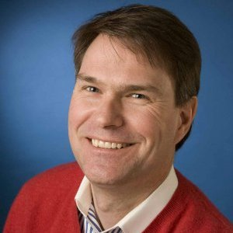
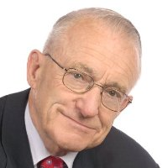
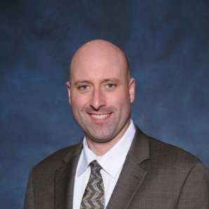
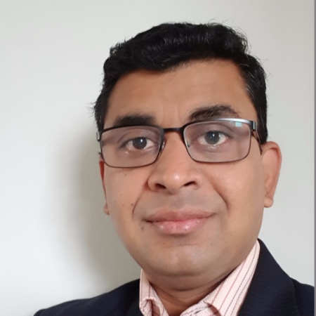
2. Call to Order, Welcome, Introductions – About the IBC Trevor Nightingale (National Research Council)
IBC Vice-Chair
Trevor Nightingale
Director
National Research Council
IBC Vice-Chair
Robert Lane
President & Managing Partner
Robert H. Lane and Associates Inc.
IBC Vice-Chair
Bob Allan
Global Business Development Manager, Intelligent Buildings
The Siemon Company
IBC Vice-Chair
Harsha Chandrashekar
Product Approvals & Regulatory Leader
Honeywell International Inc
The CABA Intelligent Buildings Council works to strengthen the large building automation industry through innovative technology-driven research projects. The Council was established in 2001 by CABA to specifically review opportunities, take strategic action and monitor initiatives that relate to integrated systems and automation in the large building sector. The Council's projects promote the next generation of intelligent building technologies and incorporates a holistic approach that optimizes building performance and savings.
http://www.caba.org/IBC

Slide 4
3. Administrative Trevor Nightingale (National Research Council)
3.1 Motion to approve past IBC Minutes: www.caba.org/IBC

Slide 5
4. “Buildings Automation Integration” Panel Discussion (30 min) Greg Walker (CABA)

Slide 6
5. Research Update Trevor Nightingale (National Research Council)
5.1 “Phase 2: Improving Organizational Productivity with Building Automation Systems”
Free Download of Phase 1: www.caba.org/productivity

Slide 7
5. Research Update Harsha Chandrashekar (Honeywell International Inc.)
5.2 “Monetization of Intelligent Buildings”
www.caba.org/Research

Slide 8
6. White Paper Sub-Committee Update Ken Wacks (Ken Wacks Associates)
6.1 Recently Completed:
“Human Skin Cells: A Potential Source of Building Contaminants”
Rajiv R. Sahay
Environmental Diagnostics Laboratory(EDLab) at Pure Air Control Services, Inc.
Alan L. Wozniak
Environmental Diagnostics Laboratory(EDLab) at Pure Air Control Services, Inc.
Rony I. Iraq
Environmental Diagnostics Laboratory(EDLab) at Pure Air Control Services, Inc.
www.caba.org/WhitePapers

Slide 9
6. White Paper Sub-Committee Update Ken Wacks (Ken Wacks Associates)
6.2 In Progress:
“Impacts of Automated Shading in Building Projects”
Ecotay Inc.
HunterDouglas
Lawrence Berkeley National Laboratory
MechoSystems, Inc.
NYSERDA
PLC Multipoint, Inc.
Siemens Industry, Inc.
Somfy
Sustainable Resources Management
TRC Energy Services
Vistar Energy Consulting
Window Products Management
www.caba.org/WhitePapers

Slide 10
6. White Paper Sub-Committee Update Ken Wacks (Ken Wacks Associates)
6.2 In Progress (continued):
“Energy Metering and Power Quality Metering: Energy Management and Billing Services for Commercial, Institutional, Multi-Family, and Industrial Applications”
ABB Inc.
Enercare Connections Inc.
EZ Meter Technologies
Schneider Electric
Sustainable Resources Management
“Automated Control Systems for Zero Emission Buildings”
Ecotay Inc.
www.caba.org/WhitePapers

Slide 11
White Paper Sub-Committee Update Ken Wacks (Ken Wacks Associates)
All proposals and previously completed IBC White Papers can be downloaded at:
www.caba.org/WhitePapers

Slide 12
7. New Business Andrew Glennie (CABA)
7.1 Featured CABA Member Benefit
www.caba.org/CIC

Slide 13
7. New Business Trevor Nightingale (National Research Council)
7.2 Other new IBC business?

Slide 14
8. Announcements Greg Walker (CABA)
8.1 Past Event Overview:
IBcon 2018 – Realcomm, June 6-7, Las Vegas, NV
InfoComm 2018, June 6-8, Las Vegas, NV
8.2 Upcoming events:
2018 NEEP Summit, Oct 2-3, Middletown, RI
interlight MOSCOW, Nov 6-9, Moscow, Russia
Greenbuild International Conference and Expo, Nov 14-16, Chicago, IL
Next IBC Meeting, Oct/Nov 2018

Slide 15
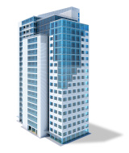
Adjournment Trevor Nightingale (National Research Council)
Continental Automated Buildings Association (CABA) 613.686.1814 Toll free: 888.798.CABA (2222)
caba@caba.org www.CABA.org
www.caba.org/IBC
Connect to what’s next™

