Slide 1
Connected Home Council (CHC)
Chair: Jay McLellan (Leviton Manufacturing Co., Inc.)
Vice-Chair: Obiorah Ike (ABB, Inc.)
Vice-Chair: Roy Perry (Alarm.com, Inc.)

Slide 2


1. Agenda
Greg Walker (CABA)
1. Agenda
2. Call to Order, Welcome, Introductions, about CHC
3. Administrative
“Connected Living: A Smart and Healthy Home” (30 min) Lainie Muller (Alarm.com)
Research Update
6. White Paper Sub-Committee Update
7. New Business
8. Announcements
9. Adjournment

Slide 3








2. Call to Order, Welcome, Introductions, About the CHC
Jay McLellan (Leviton Manufacturing Co., Inc.)
CHC Vice-Chair
Jay McLellan
VP, Energy Management, Controls and Automation Leviton Manufacturing Co., Inc.
CHC Vice-Chair
Obiorah Ike
Product Marketing Manager
ABB Inc.
CHC Vice-Chair
Roy Perry
VP Ecosystem Alliances
Alarm.com
Past CHC Chair
Yann Kulp
Director Strategy & Biz Dev North America
Schneider Electric
Established in 2004, the CABA Connected Home Council initiates and reviews projects that relate to connected home and multiple dwelling unit technologies and applications. The Council also examines industry opportunities that can accelerate the adoption of new technologies, consumer electronics and broadband services within the burgeoning connected home market.
http://www.caba.org/CHC

Slide 4
3. Administrative
Jay McLellan (Leviton Manufacturing Co., Inc.)
3.1 Motion to approve past CHC Minutes:
www.caba.org/chc

Slide 5

4. “Connected Living: A Smart and Healthy Home”
Jay McLellan (Leviton Manufacturing Co., Inc.)
Lainie Muller
Director, Health & Wellness, Strategic Sales (Alarm.com)

Slide 6
Connected Living: Smart Solutions for a Safe and Healthy Home

Slide 7
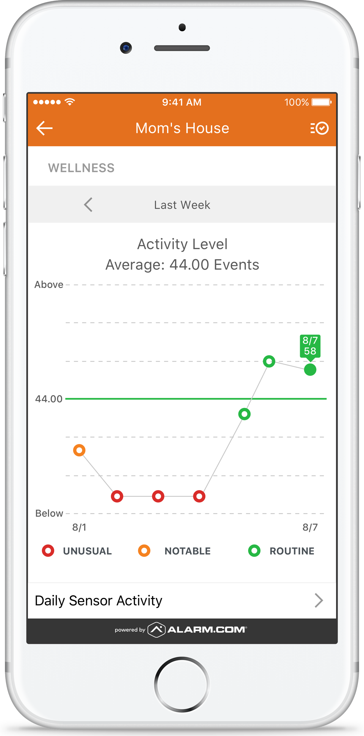
Alarm.com Wellness:
A Smart and Healthy Home
Perpetual Awareness and Insight Resulting in Timely Intervention
Use smart sensors
to keep you independent, safe and connected
Personal Emergency
Fall Detection Pendant
Voice Control: Call for Help
Activities of Daily Living Routines/Behavioral Baselines
Sensors & Visual Verification
Unexpected Activity Alerts
Optimize Control
Doorbell Camera
Automated Temperature,
Light and Lock Settings
Notes:
Alarm.com has been forward thinking in its approach to connected living. Recognizing that expectations for PERS would evolve with the use of smart sensors to keep you safe. Alarm.com’s wheelhouse is holistic and addresses these expanding consumer with one platform solution that includes smart home automation, energy management, video / voice and life safety.
In addition to providing personal emergency response, wellness allows perpetual awareness and connection resulting in proactive and preventative care models as well as timely intervention with real time sensor activity and predictive analytics.

Slide 8

Connected Living with Smart Tech
80% PARENTS interested in new tech to reduce home expenses
87%
AGE 65+ want to stay in current home as
they age
76% INTERESTED IN TECH
to monitor health at home
Notes:
There are 46 million Americans age 65+; fastest growing age group. The aging population is living longer and remaining in home longer with more chronic conditions and less savings. Older Adults cannot afford traditional senior living options long-term. There is a whopping 87% of people that want to stay in their current home as they age while 76% are interested in tech to monitor their health at home.
In addition to the elderly population, there is a population of women that are in what we like to call – the Caregiving Squeeze. These are women who are 40+ that are still providing care for children who still live at home while also caring for aging parents who are facing:
An increase caregiver burden
Increasing healthcare costs
While there is a shortage of healthcare professionals
These factors coming together is driving the adoption of technology.

Slide 9
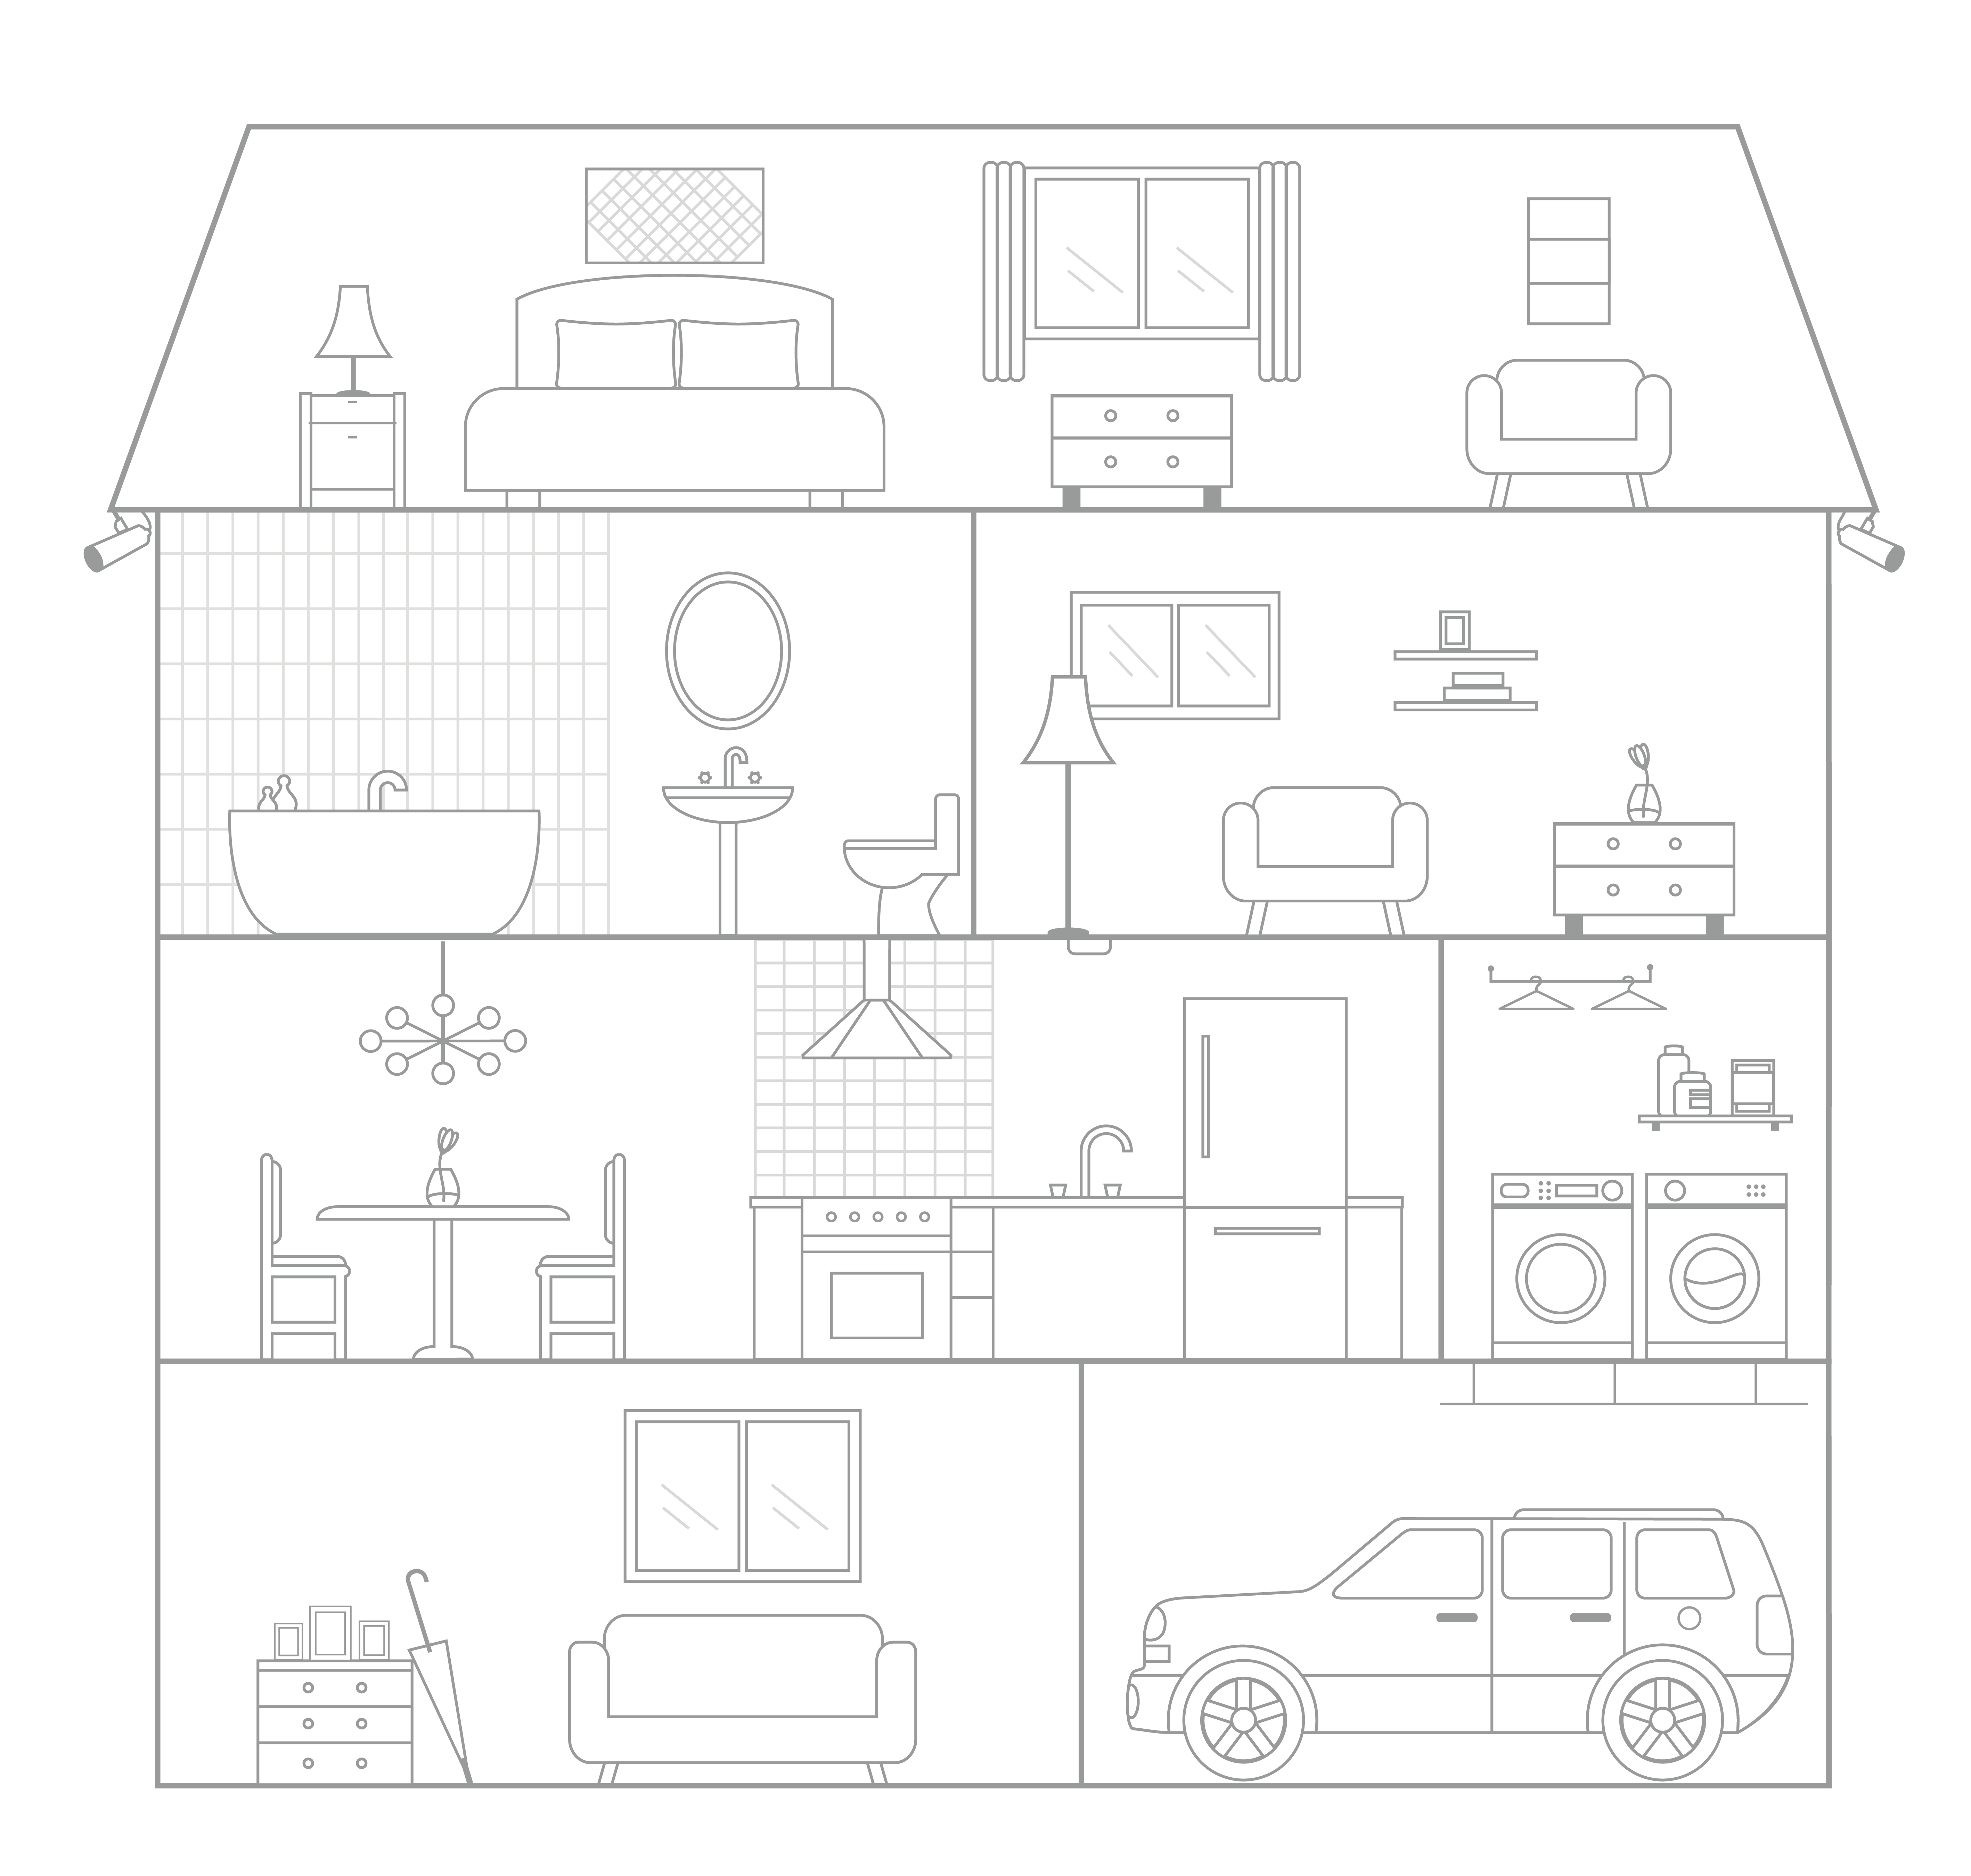















Possible Hardware:
Control Panel
Motion Sensor
Door Sensor
Medication Management Sensor
Bed Sensor or Chair Sensor
Panic Pendant
Wellness Emergency Button
Smart Thermostat
Lights
Locks
Water Sensor, Shut-off Valve
Doorbell Camera
Image Sensor
Video Camera
Notes:
***List & icons animate in automatically
Add new app capture and updated dashboard with new design

Slide 10
Wellness Top Ten Smart Home Use Cases
Ratings based on a 7-pt. scale. Among U.S. BB HHs Surveyed, n – 2,501, ±1.96% Source: ConnectHealthSummit.com / Parks Associates
Notes:
Creative: can we make this chart larger?
As you can see from the data provided by Parks and Associates in Q2 of 2017, it is expected that an intelligent home would be able to support falls, personal emergency and life safety issues.

Slide 11
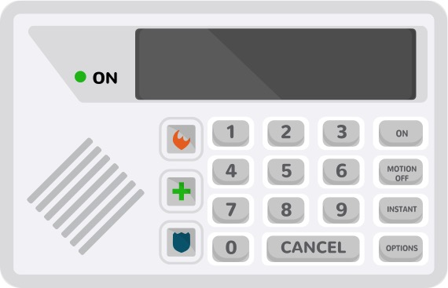

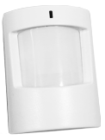

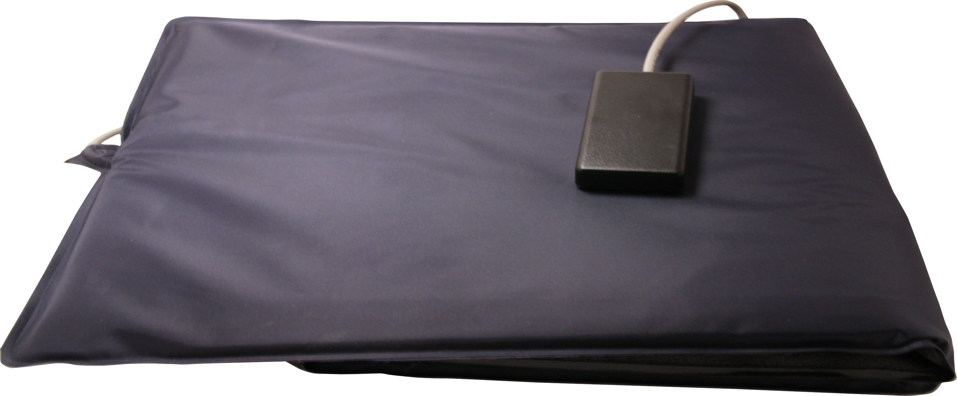
Essentials Package
Security Panel
Motion Sensor
Door Sensor
Bed/Chair Sensor
Panic Pendant with Fall Detection
Sample hardware pictured above.
Notes:
Creative:
Can you help simplify this? Maybe it needs to be 2 slides…….the text is so small.
Can you add Amazon Echo and Google Voice images and text to Enhanced Offer

Slide 12
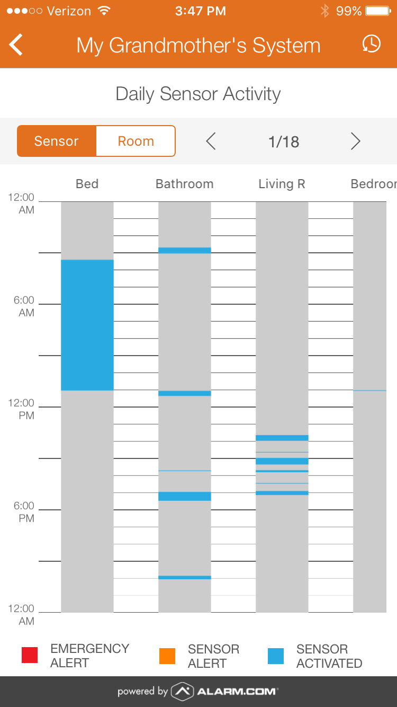
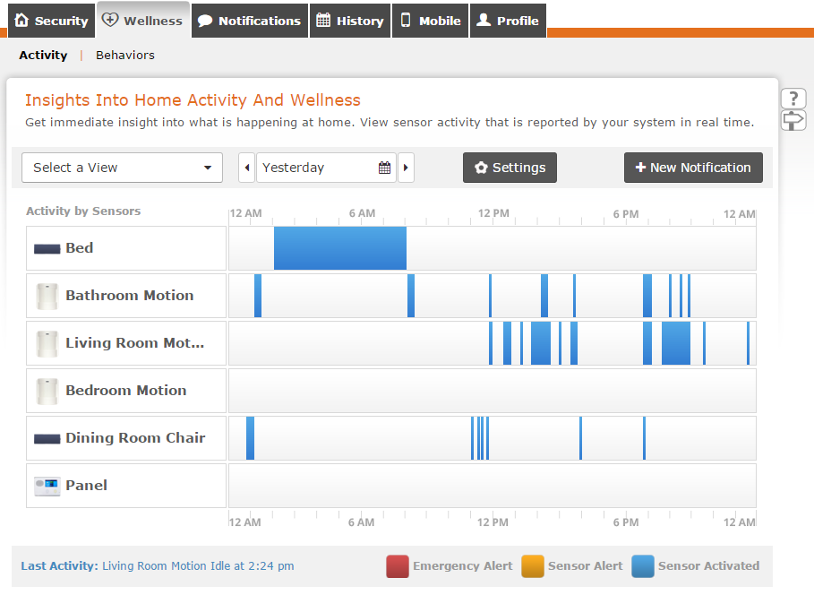
Visualize Sensor Activity
Notes:
-Customers will be provided with a new view of activity in the home, which will enable check-ins of resident status at anytime.

Slide 13
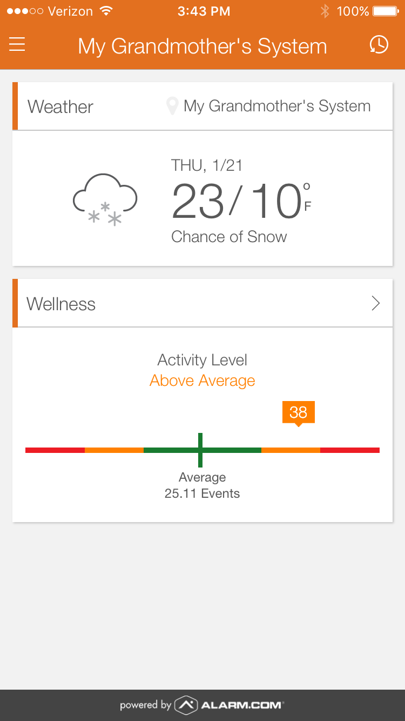
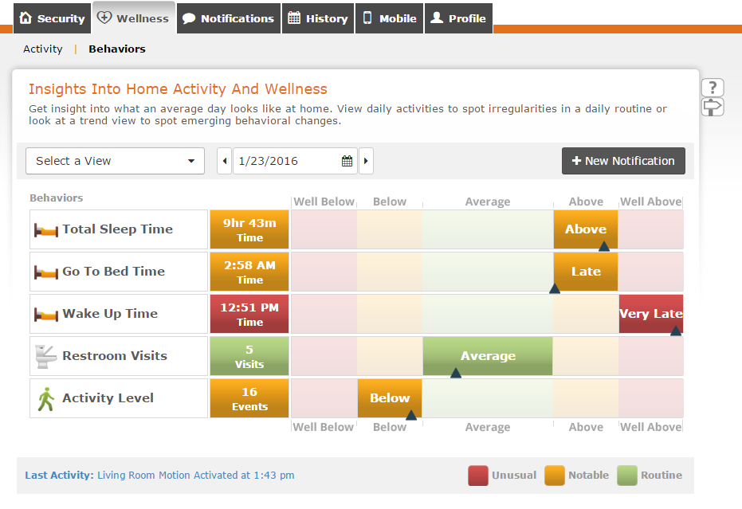
View Key Behaviors

Slide 14
Commercial
Healthcare Market
Notes:
SCRIPT:
Now that we’ve discussed our platform in depth, I want to talk about ways to use our offering to capture new markets. I’m very excited about sharing this section with you as I have seen a number of our service providers embrace the ideas I am about to share and it has altered their business with strong, new revenue growth.

Slide 15
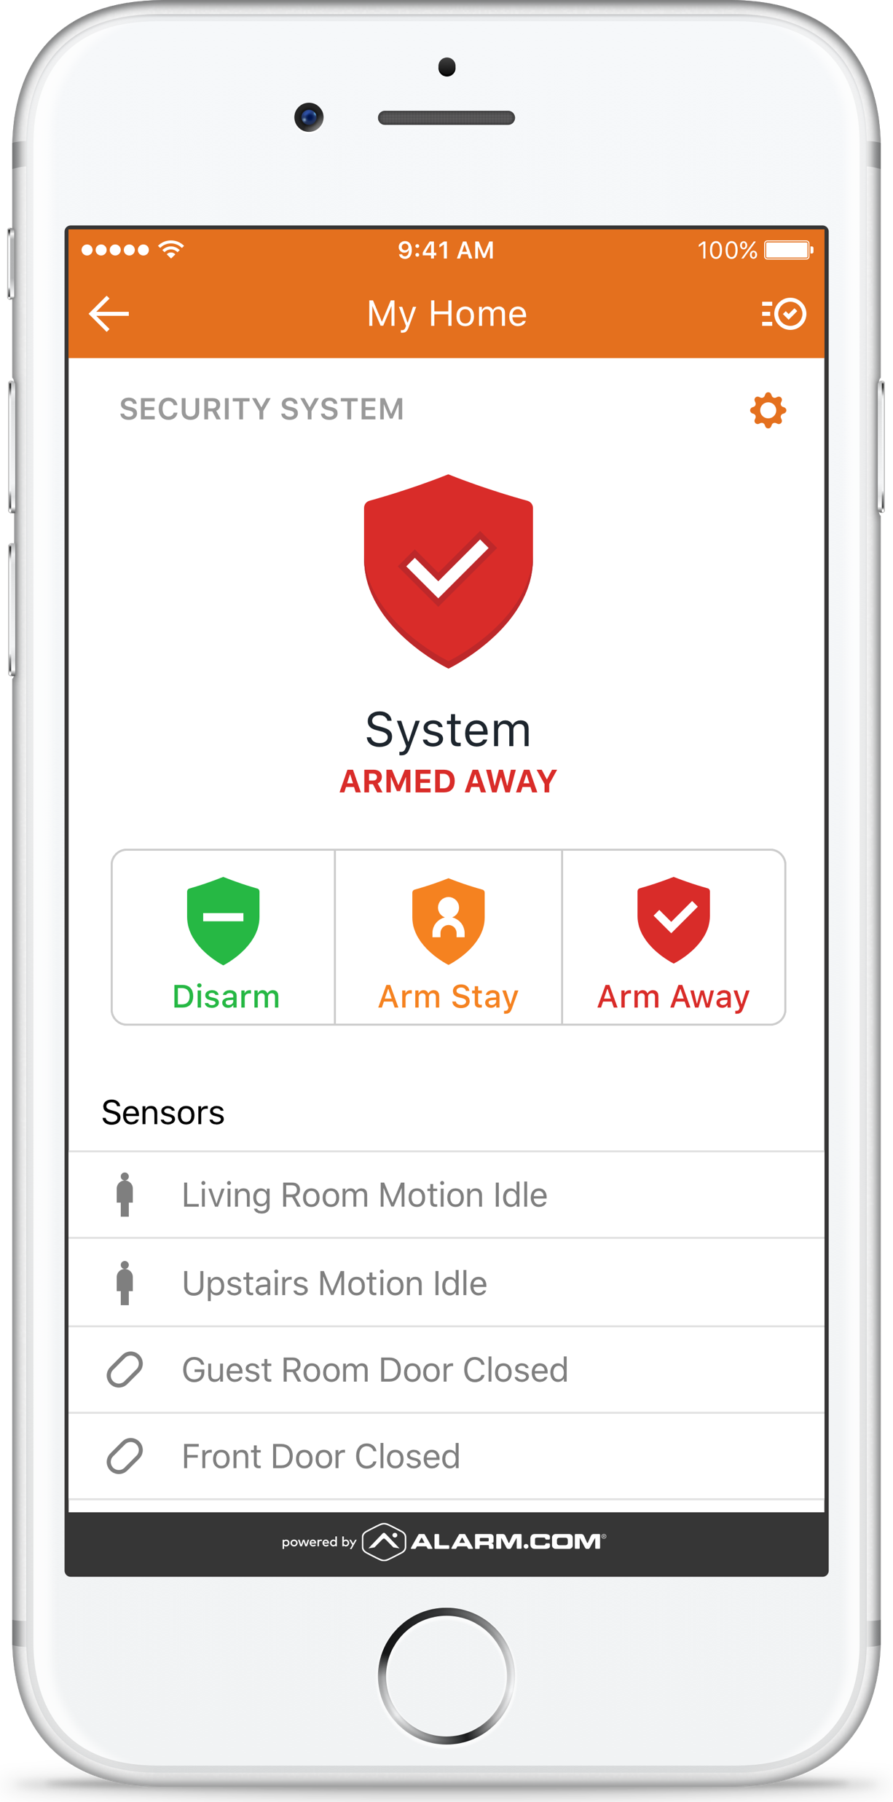

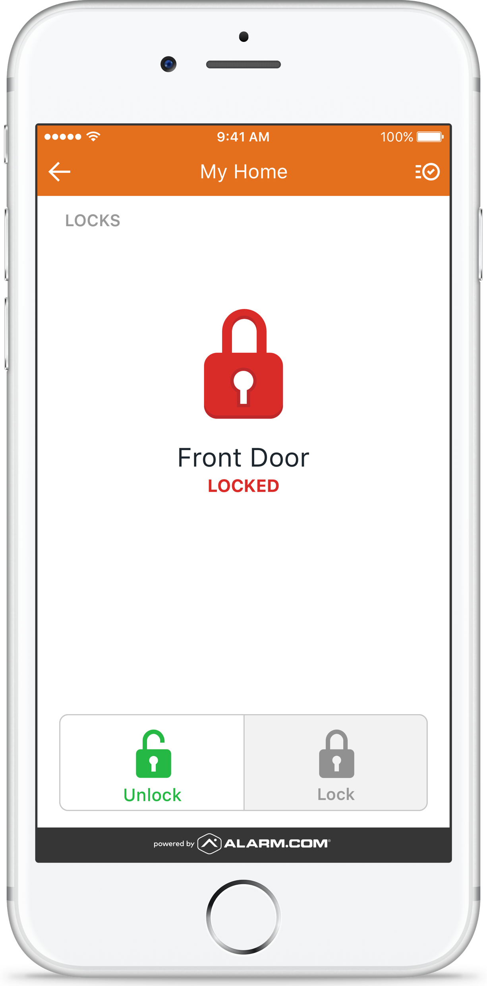
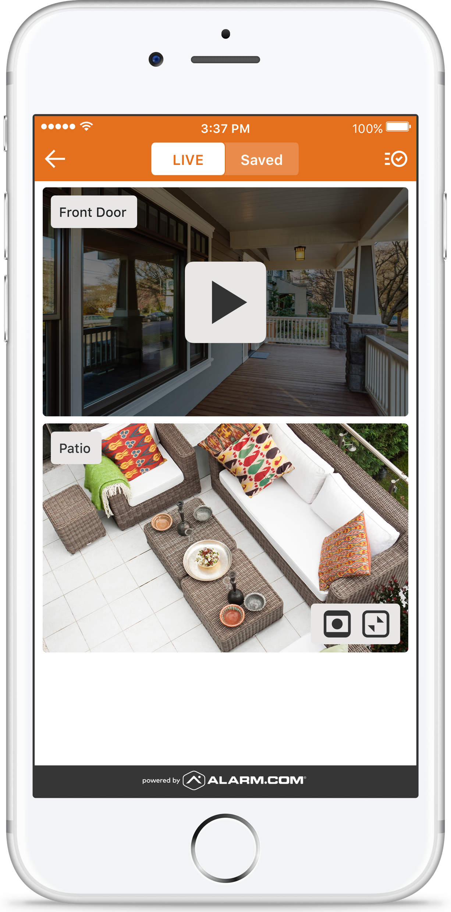
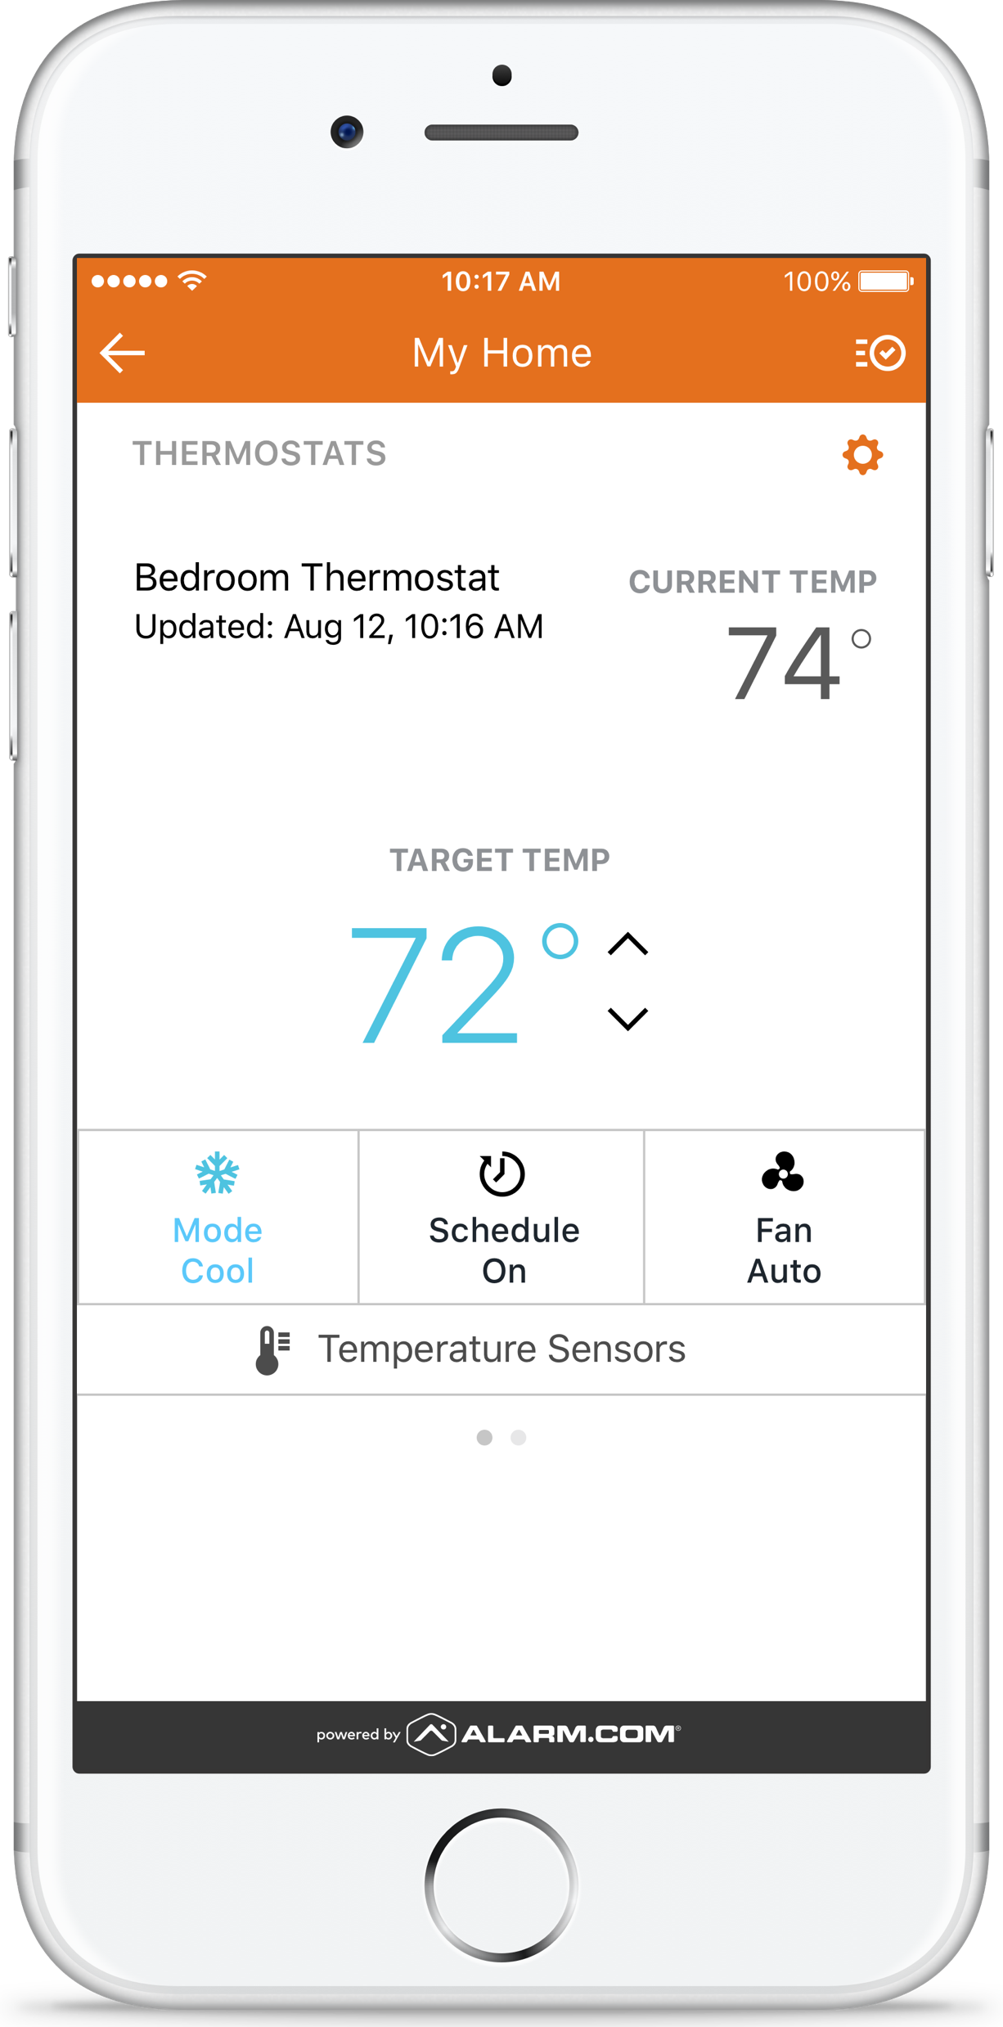
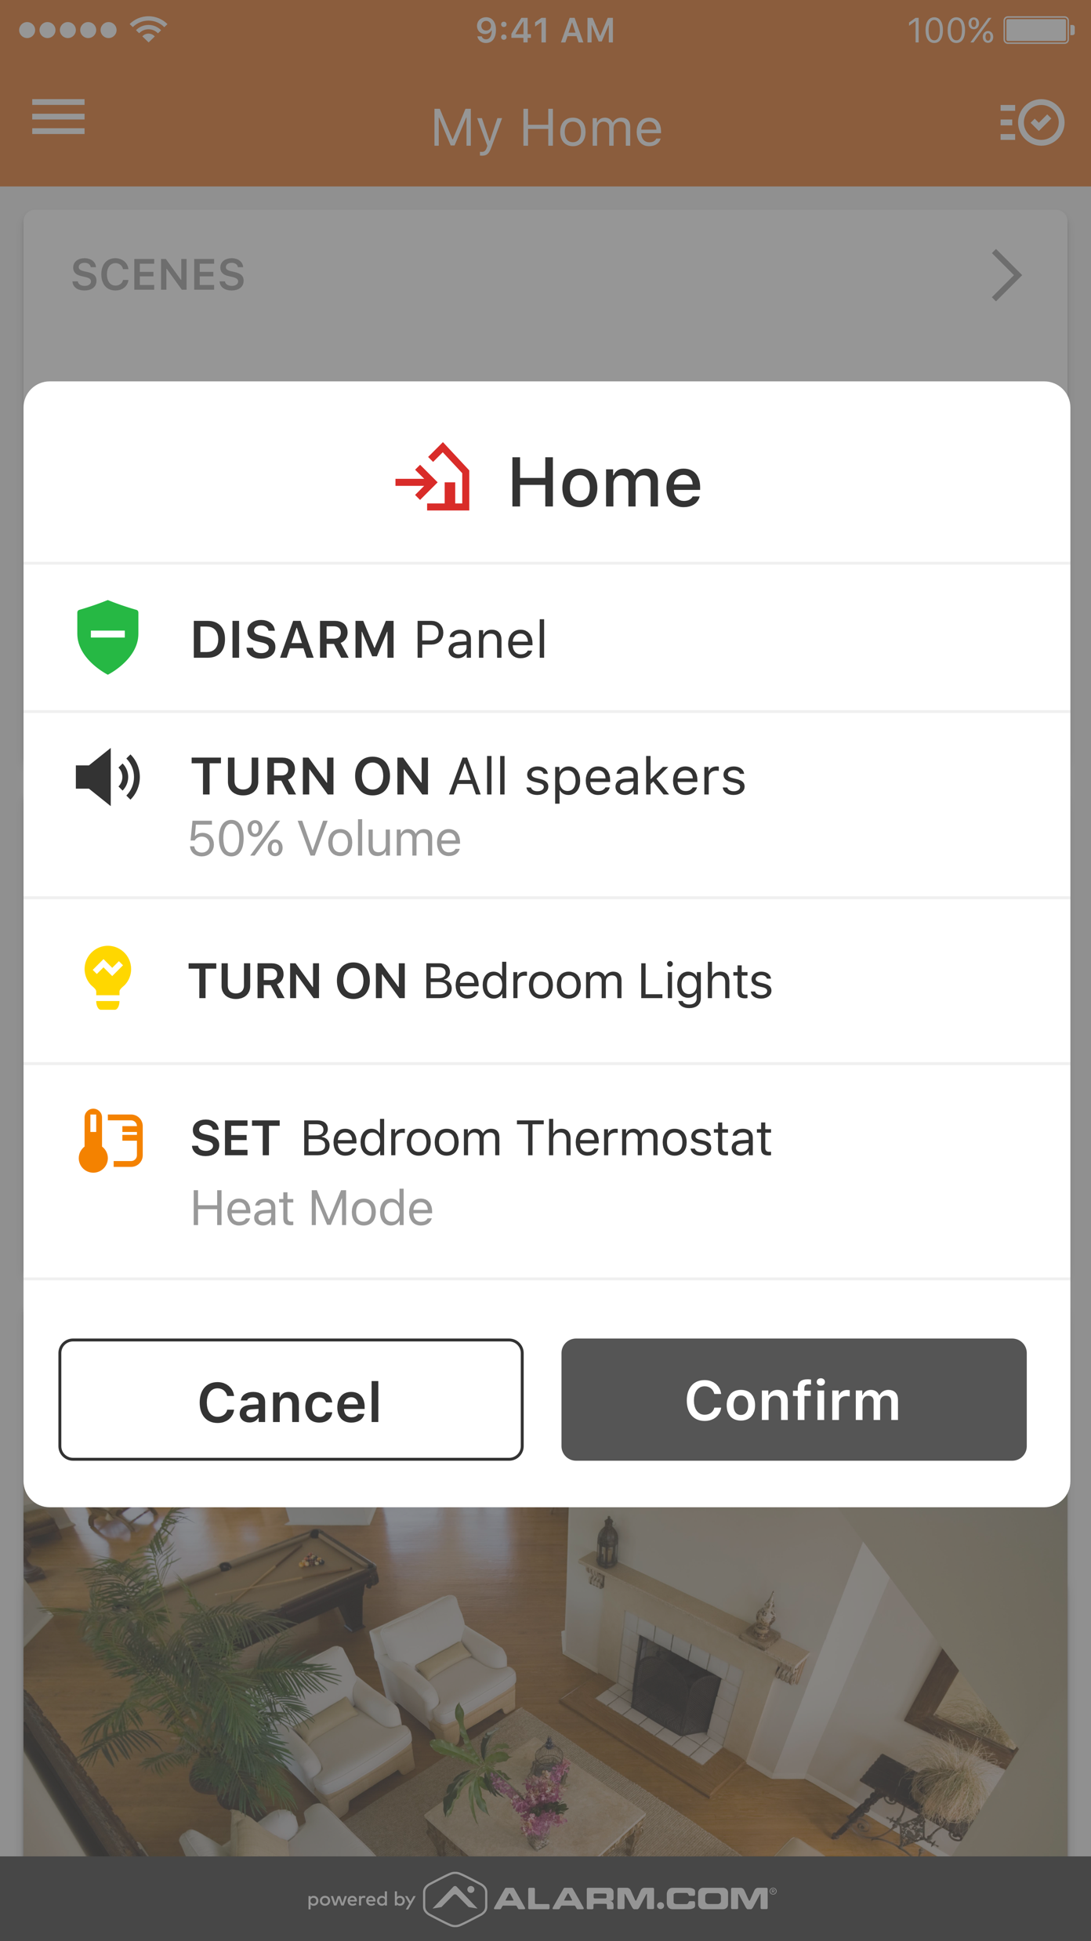
Commercial Healthcare Market
Senior Living Communities
A Fully Integrated Turnkey Solution
Security
Automation
Access
Video
Energy
Wellness
Notes:
Script: Our goal with all these options is make the offering simple with the ability to expand when needed. Key components of the property management needs are security (by apartment / common areas), video, energy, access control and enhanced by our wellness offering. No other competitor can offer so much under one umbrella.
NOTE: : Property managers are extremely interested in home automation and I don't want that to be missed in this slide. I think we add "Automation" and change the order. (1) Automation, (2) Access, (3) Video, and (4) Security as the anchor/focus of everything we do. I still think we need to think about energy and wellness. Trying to position our the differentiators.

Slide 16
Enterprise Dashboard for
Healthcare Market
Notes:
Creative: can you make the screen bigger? Maybe a full screen or zoomed in version. Maybe combined with the following 2 slides that are a deep dive?
Here is an example of what our enterprise solution looks like. This shows that we can see an entire population from a single screen.

Slide 17

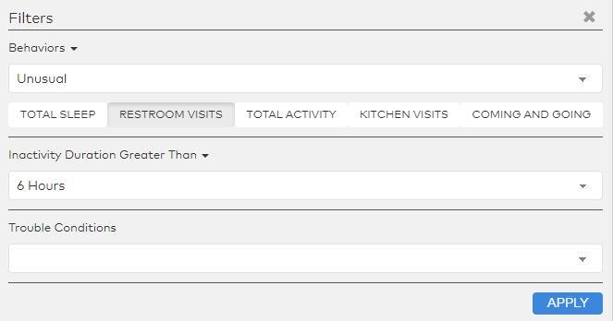
SLEEP
RESTROOM
EXITS
MEALS
TOTAL ACTIVITY
Behaviors & Filters
Notes:
I wanted to take a deeper dive into the staff facing Enterprise dashboard.
We profile the following types of Behaviors on the locations page
Previous Day’s Behavior: Total Sleep
Same-day Behavior: Bathroom Visits, Entries & Exits, Kitchen Visits, and Total Activity
If a behavior is not being profiled for the user; i.e. they have no device in that room, the icon is disabled
For same-day calculated behaviors, rolling over the icon will present the average value we expect to see at that point in the day. This can be used for a comparison to the current day value.
Example: By noon, a resident may on average have 5 restroom visits; however, today they have 9.
The color of the circle is the Wellness Behavior comparison for the same day values – in the example above, the user would probably have a red circle because the behavior at noon is far off average
Use filters to narrow the scope of visible accounts. This can be used to better allocate nursing staff to those with the most need or to get a general overview of the population.
Filters are currently broken down by three different types:
Behaviors – select a (or more than one) behavior along with its status; e.g. show me accounts where bathroom visits and kitchen visits are unusual
Last Activity Duration – select a time since last activity
Trouble Conditions – from a system maintenance perspective, find accounts that need dealer assistance
Filters can be used in concert with each other – for example, combine looking at accounts with unusual behaviors and a long period of inactivity

Slide 18

Independent Group Control
Features
Notifications
  High/Low Temperatures
  Trouble Conditions
  Water Leak Detected
  Nighttime Safety (Away from Bed, Still in Bed)
  Up & About
  Personal Emergency
  Weather Alerts
Configurations
Residents
Caregivers
Maintenance Supervisor
Login Access
  Manager
CONTINUING CARE RETIREMENT COMMUNITIES
INDEPENDENT LIVING
ASSISTED LIVING
COMMON AREAS
101
201
103
202
OFFICE
POOL
102
203
104
LOBBY
GYM
204
Notes:
Let me what through examples.
Water leak detections
Door left open alert
Light schedules for safety
Local thermostat lock – energy savings.
Vacant property control – video cameras?

Slide 19

Sales Opportunities
Smart Home
Your home is the next health wearable
Connected Health
Technology enabled care models at home
Smart Cities
Government assistance programs with “holistic” solutions
Smart Communities
Enterprise Wellness for Population Health Management
Notes:
In summary, as you formulate your wellness strategy, I ask you to consider several sales opportunities:
- Using the smart home as the next health wearable
- Creating technology enabled care models at home
- Innovative things with government funding and assistance around holistic approaches. For example, we have a dealer partner in Missouri who is using technology as part of a Medicade waiver program to support people living with disabilities
- Lastly, outfitting smart communities with our enterprise wellness solution to increase the profitability, occupancy rates, efficiency and responsiveness of the community for its residents.

Slide 20

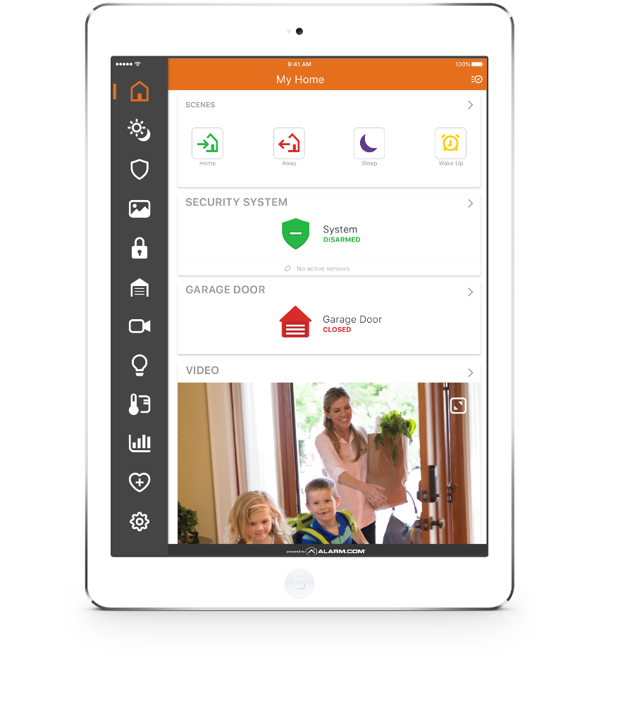
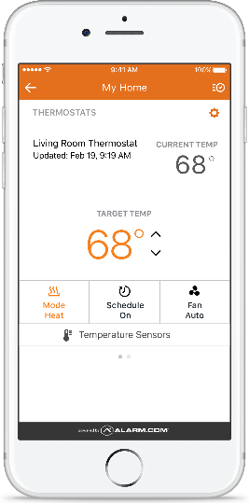
Comprehensive
Platform Solutions
Notes:
Script: The Alarm.com offering is based on life safety and has expanded into automation, energy management, wellness and video monitoring solutions over the year. This holistic offering is comprehensive and is accessible though any web device. What we have found in partner surveys is that customers appreciate a solution that provides all the shiny objects while property managers want to impact their bottom line. We feel we can do both with the Alarm.com platform.

Slide 21


5. Research Update
Obiorah Ike (ABB, Inc)
5.1 “Connected Home IoT Energy Roadmap”
www.caba.org/research
CABA Connected Home Council (CHC)

Slide 22

5. Research Update
Roy Perry (Alarm.com)
5.2 “Connected Home Roadmap and Artificial Intelligence”
www.caba.org/research
CABA Connected Home Council (CHC)

Slide 23
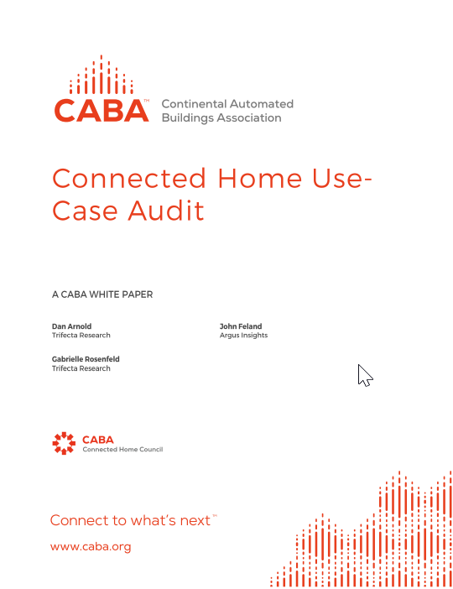
6. White Paper Sub-Committee Update
Derek Cowburn (Lumen Cache, Inc.)
6.1 Recently Completed:
“Connected Home Use Case Audit”
Argus Insights, Inc.
Core Brands
Online Trust Alliance (OTA)
Panasonic Corporation
Schneider Electric
TELUS
Trifecta Research
Z-Wave Alliance
www.caba.org/WhitePapers

Slide 24

6. White Paper Sub-Committee Update
Derek Cowburn (Lumen Cache, Inc.)
6.2 In Progress:
“The future delivery/business models for Smart Home services and infrastructure”
Asian Institute of Intelligent Buildings
BC Hydro
Bedrock Learning, Inc.
behome247
CaSA
Chamberlain Group, Inc.
Frost & Sullivan
Independent Consultant
Intermatic Inc.
NEEP
Paremus
Schneider Electric
Sustainable Resources Management Inc.
Sykes Assistance Services Corporation
Z-Wave Alliance
www.caba.org/WhitePapers

Slide 25

6. White Paper Sub-Committee Update
Derek Cowburn (Lumen Cache, Inc.)
All proposals and previously completed CHC White Papers can be downloaded at:
www.caba.org/WhitePapers

Slide 26


7. New Business
Andrew Glennie (CABA)
7.1 Featured CABA Member Benefit
The CABA Information Council identifies and reviews white papers and research for the CABA Information Series, the most authoritative source for technical information in the home and large building automation sectors. CABA Information Series reports are published both in the CABA Public Research Library and the CABA Member Research Library.
www.caba.org/CIC

Slide 27
7. New Business
Jay McLellan (Leviton Manufacturing Co., Inc.)
7.2 New CABA Member Benefit: Dealers, Distributors and Integrators access to CABA Member Research Library
- Andrew Glennie (CABA)

Slide 28

7. New Business
Jay McLellan (Leviton Manufacturing Co., Inc.)
7.3 Other new IBC business?

Slide 29

8. Announcements
Greg Walker (CABA)
8.1 Past Event Overview:
CONNECTIONS 2018, May 22-24, San Francisco, CA
8.2 Upcoming events:
Shanghai Smart Home Technology, Sept 3-5, 2018, Shanghai, China
CEDIA Expo, Sept 4-8, San Diego, CA
Next CHC Meeting, Oct/Nov 2018

Slide 30
9. Adjournment
Jay McLellan (Leviton Manufacturing Co., Inc.)
Continental Automated Buildings Association (CABA)
613.686.1814
Toll free: 888.798.CABA (2222)
caba@caba.org
www.CABA.org
www.twitter.com/caba_news
www.linkedin.com/groups?gid=2121884
www.caba.org/chc
Connect to what’s next™

